Slide 1

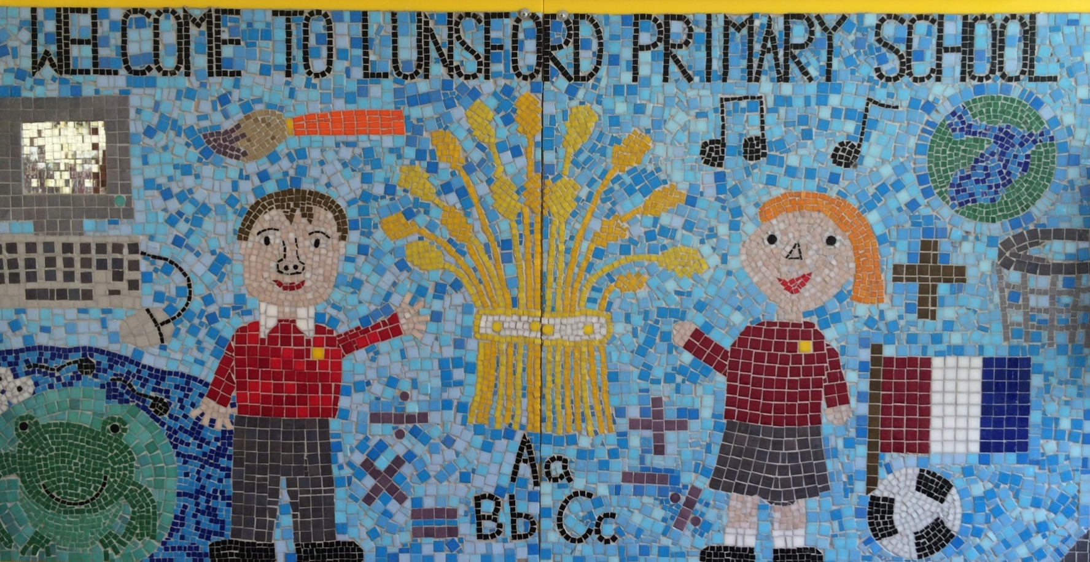
Lunsford Primary School
Welcome to our school!

Slide 2
Who’s Who?
Headteacher – Mr G Anscombe
Deputy Headteacher – Mrs E Lomax
Class Teachers – Mrs Gardner (Monday – Thursday)
- Mrs Wheeler (Friday)
Class Teaching Assistant – Mrs Bruckin (all week)
PPA cover – Mrs Calloway (Wednesday am)
SENCO – Ms S Beckett ( Tues, Wed, Thurs)
FLO – Mrs A Taylor
Office Manager – Mrs K Mead

Slide 3

Our Values:
Kindness Respect Positivity Perseverance Responsibility Hard work
OUR VALUES
We are KIND
We are RESPECTFUL
We are POSITIVE
We PERSEVERE
We are RESPONSIBLE
We are HARD WORKING

Slide 4
Our School Rules
Be SAFE
Be READY
Be RESPECTFUL

Slide 5
SCHOOL RULES – SAFE, READY, RESPECTFUL.
There are just 3 simple, clear and coherent behaviour expectations.
This makes it easy for adults and children to recognise good behaviours and expectations.
They are easy to follow and easy to remember enabling all children and all adults to embrace them.

Slide 6
BE SAFE
We are SAFE when:
we move around school in a safe manner;
we follow instructions to keep ourselves safe e.g. on school trips;
we use equipment safely;
we stay safe online;
we cross roads safely;
we keep our hands and feet to ourselves…

Slide 7
BE READY
We are READY to learn when:
we arrive at school on time;
we have our equipment ready;
we show that we are listening,
we are ready to start lessons;
ready to listen and follow instructions.

Slide 8
BE RESPECTFUL
We are RESPECTFUL when:
we listen when others speak;
we respect the property of our friends and the school;
we show manners;
we consider others' feelings;
we focus our attention;
we show effort

Slide 9
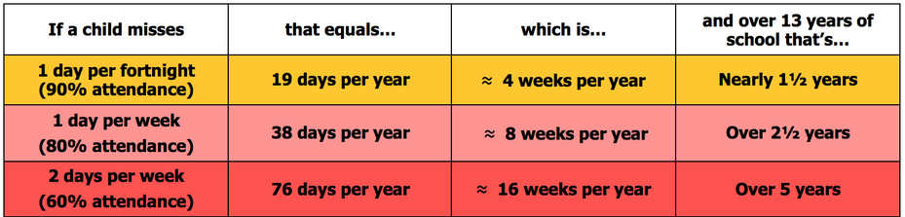
Attendance
Lunsford Primary monitors the attendance of every child in the school. We work with and support those children and their families who are not attending school without sufficient reason. Our attendance target for this academic year is 96.5% attendance.
To put this in perspective 95% sounds good, but means that your child misses:
one half day each fortnight
two weeks every school year
over three-quarters of a school year in a school career
Notes:
GA KM

Slide 10


Attendance
A key factor in a child’s success at school is regular and punctual attendance.
We will reward good attendance.
We will be robust in chasing up poor attendance and children who are persistently late.
Term-time holidays will not be authorised unless there
are exceptional circumstances.
Notes:
GA KM

Slide 11
Uniform
The expectation is that all children will wear the correct school uniform. This includes smart, black shoes.
No such thing as inappropriate weather – only inappropriate clothing!
Sweatshirt, Polo Shirt, Black/grey trousers/skirt, summer dresses – red and white
PE Kit in to be worn on PE days with their school jumper.
Labelled please
Order from Brigade online.
We want to foster and develop a real pride in our school from the very beginning
Notes:
GA EL

Slide 12


Slide 13
Welcome to Elephant Class!
We really want to work together with you as parents, to ensure all the children have the best year possible.

Slide 14
Our Topics
Autumn Term
The Naughty Bus
Astro Girl
Dragon Pos
Spring Term
The Odd Egg
The Comet
Julian is a Mermaid
Summer Term
Beegu
Lubna and Pebble
The Sea Saw
More information can be found in the class newsletters

Slide 15
Phonics / Spellings
In year 1 we continue using Little Wandle. We start by recapping the Phase 3 sounds and then slowly introduce Phase 5. Phonics is taught daily in term 1 and twice daily in terms 2-6. Any children that need additional help will also receive extra support and you will be made aware of this at parents evening in October.
Phonics is really important this year as every child must sit the phonics screening in June. This is a government test where the children have to read 40 words. The pass mark is 31/32. We will hold a phonics workshop with more information closer to the time.

Slide 16
Number Bonds / Times Tables
Number bonds and number facts are so important and this knowledge supports student’s Maths work throughout the school.
We have invested in Numbots and will be using this weekly in school and we would like them to use at home as well. Login details are inside their reading records.
Please encourage your child to practice their Maths at home.
We don’t teach formal times tables in year 1 but the children will learn to count in steps of 2s, 5s and 10.

Slide 17
Reading
Please read with your child daily, 2 pages a night is better than nothing and it can be made fun by taking it turns to read alternative pages with an adult if your child is struggling to engage. We have several incentives to help read.
Buster’s Book Club is a primary school initiative that encourages children to read at home with their parents or carer. Whatever they read and whoever they read to, the minutes are recorded on a bookmark and added to the class total every Wednesday morning.
Race to read. Each child has their own race car and will move along the track everytime that they read. The track has 30 markers, when they reach 10 they will be awarded 5 dojo points and 5 housepoints. When they reach 20 they will receive a certificate and if they reach the end they will get to choose a prize from the prize box.
Elephant bag. Every child in the class will get a turn with the bag throughout the year. Please enjoy the books and biscuits inside with your child and will in the diary for us to share in class. The bag will come home on a Friday and needs to be returned the following Thursday please, if possible with the biscuit box refilled.

Slide 18
Homework
∗Homework will be sent home on a Thursday and needs to come back the following Wednesday for marking.
∗Homework should only take approx. 20 minutes.
∗It will be the same format every week, a Little Wandle phonics sheet, a Little Wandle handwriting sheet and a few maths questions recapping what we have done that week.
Please complete homework in pencil.

Slide 19
PE
Mondays with Mr Dickinson
Tuesdays with Mrs Gardner
Children to wear PE kit on PE days
Earrings must be taken out and long hair tied back.
Please make sure all items of PE kits and uniform are named.

Slide 20
Assessment
Ongoing informal assessments during the year for all subjects.
We assess the children regularly and also conduct Pupil Progress Meetings three times a year to ensure your child is on track to meet their targets.
If you have any concerns about your child and their progress, please make an appointment to see one of us.

Slide 21
Online Safety
Many Lunsford children regularly use the internet and social media and we have a duty to help them keep safe online.
Users should be sixteen to use WhatsApp and thirteen to use Instagram, Snapchat, Twitter, Facebook, Skype and TikTok.
Although there is no age restriction for watching YouTube videos, users need to be thirteen to have their own YouTube account enabling them to subscribe to channels, like videos, post comments and add videos.

Slide 22
Online Safety
If your child does use social media, please help them to check their privacy settings, disable any chat settings and ensure they know how to block and report.
www.net-aware.org.uk provides lots of up-to-date information for parents.
Please let us know if there any issues regarding the online behaviour of Lunsford children at any time.
We will always follow this up within school in line with our online safety, safeguarding, behaviour and acceptable use policies.
Please see Mrs Lomax if you have any other queries about online safety.

Slide 23
Getting in Contact
At Lunsford, we have an open door policy. We want to work in partnership with parents and carers and strive to achieve the best for all children.
We ask that if you have any worries or questions regarding your child or a problem related to school, please do not hesitate to contact us so we can understand your concerns and help to solve any issues . If we do not know there is a problem, it is very difficult for us to help you or your child.
If you feel that an issue has not been dealt with appropriately, please speak to Mr Anscombe or Mrs Lomax, or we will happily provide you with a copy of the formal complaints procedures.

Slide 24
Getting in Contact
If you would like to speak to a member of staff…
Mrs Mead will forward on any emails and pass on any telephone messages.
We can be contacted via Class Dojo. We will try to reply as soon as possible (within 24 hours during the week) but urgent messages should be sent via the office as we will not necessarily be able to access Dojo whilst we are teaching!
A member of the Senior Leadership Team will also be available on the playground every morning and afternoon.
Our Family Liaison Officer (FLO) Amy Taylor can be contacted on 07552 045390.

Slide 25
Lunsford Primary School
Welcome to our school!

