Slide 1

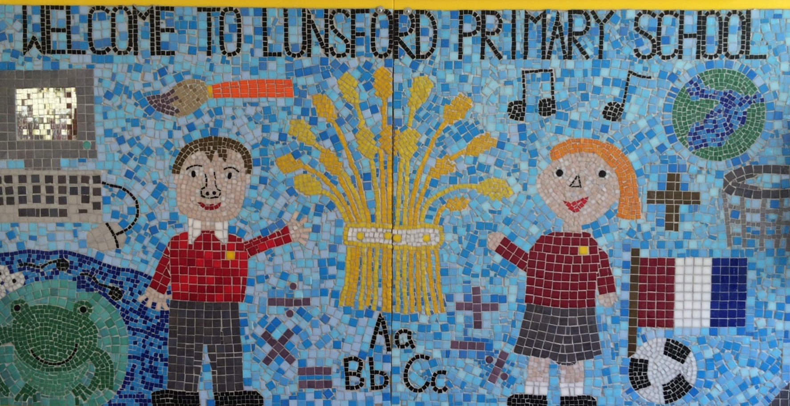
Lunsford Primary School
Welcome to our school!

Slide 2
Who’s Who?
Headteacher – Mr G Anscombe
Deputy Headteacher – Mrs E Lomax
Koala Class Teacher – Miss Broadmore PPA Cover- Mrs Wheeler (Wednesdays- this will alternate each term mornings and afternoon)
Koala Class Teaching Assistants – Mr Murray (Wednesday afternoons, Thursday and Friday) and Mrs Barton(Please note Mrs Barton does not work on a Friday)
SENCO – Ms S Beckett ( Tues, Wed, Thurs)
FLO – Mrs A Taylor
Office Manager – Mrs K Mead

Slide 3

Our Values:
Kindness Respect Positivity Perseverance Responsibility Hard work
OUR VALUES
We are KIND
We are RESPECTFUL
We are POSITIVE
We PERSEVERE
We are RESPONSIBLE
We are HARD WORKING

Slide 4
Our School Rules
Be SAFE
Be READY
Be RESPECTFUL

Slide 5
SCHOOL RULES – SAFE, READY, RESPECTFUL.
There are just 3 simple, clear and coherent behaviour expectations.
This makes it easy for adults and children to recognise good behaviours and expectations.
They are easy to follow and easy to remember enabling all children and all adults to embrace them.

Slide 6
BE SAFE
We are SAFE when:
we move around school in a safe manner;
we follow instructions to keep ourselves safe e.g. on school trips;
we use equipment safely;
we stay safe online;
we cross roads safely;
we keep our hands and feet to ourselves…

Slide 7
BE READY
We are READY to learn when:
we arrive at school on time;
we have our equipment ready;
we show that we are listening,
we are ready to start lessons;
ready to listen and follow instructions.

Slide 8
BE RESPECTFUL
We are RESPECTFUL when:
we listen when others speak;
we respect the property of our friends and the school;
we show manners;
we consider others' feelings;
we focus our attention;
we show effort

Slide 9
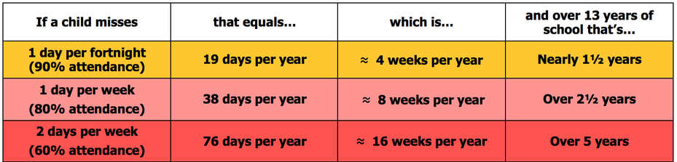
Attendance
Lunsford Primary monitors the attendance of every child in the school. We work with and support those children and their families who are not attending school without sufficient reason. Our attendance target for this academic year is 96.5% attendance.
To put this in perspective 95% sounds good, but means that your child misses:
one half day each fortnight
two weeks every school year
over three-quarters of a school year in a school career
Notes:
GA KM

Slide 10


Attendance
A key factor in a child’s success at school is regular and punctual attendance.
We will reward good attendance
We will be robust in chasing up poor attendance and children who are persistently late
Term-time holidays will not be authorised unless there
are exceptional circumstances
Notes:
GA KM

Slide 11
Uniform
The expectation is that all children will wear the correct school uniform. This includes smart, black shoes.
No such thing as inappropriate weather – only inappropriate clothing!
Sweatshirt, Polo Shirt, Black/grey trousers/skirt, summer dresses – red and white
PE Kit in to be worn on PE days
Labelled please
Order from Brigade online.
We want to foster and develop a real pride in our school from the very beginning
Notes:
GA EL

Slide 12
Welcome to Koala Class!
Year 4 is a very exciting year with lots of new opportunities for the children including learning to play the violin and a 2 night trip to PGL!
We really want to work together with you as parents, to ensure all the children have the best year possible.

Slide 13
Koala Class expectations
As the year progresses, we are keen for the children to develop their independence, particularly in preparation for their transition to upper KS2.​
With this in mind, we have high expectations for both work and behaviour including:​
Presentation of work​
Positive attitude to learning​
Concentration / being ready to learn each lesson​
Working to full potential​
Taking responsibility

Slide 14
Our Topics
Autumn Term
History- Ancient Greece
Geography- Biomes
Science- States of Matter and Animals including Humans
Spring Term
History- Ancient Egypt
Geography- The United Kingdom
Science- Sound and Electricity
Summer Term
History- Anglo Saxons
Geography- Europe
Science- Living Things and their habitats

Slide 15
Spellings
In Year 4, spellings will be taught twice a week focusing on the Y3/4 word lists and spelling patterns from the National Curriculum.
We will be following Spelling Shed. Children will be tested through a Spelling Hive on the words they have learnt that week.
It would really benefit your child if you are able to spend time on Spelling Shed to consolidate their learning.
A list of Y3/4 spellings are on our class page on the website.

Slide 16
Times Tables
Times tables are extremely important this year.
Quick recall of times tables and the related division facts are vital for success in Maths in Year 4 and beyond.
June 2027- a timed multiplication tables check for all Y4 pupils
This will be completed online in school

Slide 17
Times Tables
Times tables will be taught every day in school.
Tested once a term- soundcheck on TT Rockstars
Children will have a written times tables test fortnightly on a Friday morning
We will continue to use Times Table Rockstars
All children have an individual login. These are stuck in their reading records
Please encourage your child to access TT Rockstars at home as much as possible. Little and often is best!

Slide 18
Reading
-Regular reading continues to be of key importance in Year 4, even if your child is a confident reader.
Comprehension skills are taught 3 times a week in school focusing on reading strategies, vocabulary and comprehension.
There are a list of questions in reading records you can ask your child to support their comprehension skills.
BUSTER BOOK CLUB- Please ensure any reading is recorded in children’s reading records. Bookmarks will be in their reading records where you can record the number of minutes read. Reading on a Wednesday will count, any books count!

Slide 19
Homework
Homework will be a Maths task and a reading comprehension.
Please ensure presentation is neat in homework books.
Homework will be sent home on a Thursday to be returned the following Wednesday.
Please encourage your child to ask an adult if they are struggling with any homework. Please do this before it is due. I am always happy to help!
Children will mark their own homework as we go through the answers altogether in class.

Slide 20
PE
Monday with IMPACT
Tuesday with Miss Broadmore
Outdoor Games Trainers (which might get muddy), PE t-shirt, shorts, jogging trousers, sun hat for summer, spare socks (for those wearing tights).
Children to wear PE kit on PE days
Earrings must be taken out and long hair tied back.
Please make sure all items of PE kits and uniform are named.

Slide 21
PGL
PGL will be 17th-19th March 2027
Sign up deadline has finished.
I will do a meeting with parents closer to the date with all relevant information
I will also post payment deadlines on Dojo for you.

Slide 22
Violins
This year, children will be learning to play the violin every Thursday morning.
Violins are provided and children will be able to bring them home at the end of Term 2.

Slide 23
Assessment
Ongoing informal assessments during the year for Reading, Writing and Maths.
We assess the children regularly and also conduct Pupil Progress Meetings three times a year to ensure your child is on track to meet their targets.
If you have any concerns about your child and their progress, please make an appointment to see Miss Broadmore.

Slide 24
Online Safety
Many Lunsford children regularly use the internet and social media and we have a duty to help them keep safe online.
We know it is hard to keep up with the apps and websites available to young people, but understanding the risks and implementing preventive measures can go a long way in protecting your child.
Users should be thirteen to use Whatsapp, Instagram, Snapchat, Twitter, Facebook, Skype and TikTok.
Although there is no age restriction for watching YouTube videos, users need to be thirteen to have their own YouTube account enabling them to subscribe to channels, like videos, post comments and add videos.

Slide 25
Online Safety
If your child does access the internet or social media, we strongly recommend that no children are allowed unsupervised access to mobile phones, tablets, game consoles or any internet enabled devices eg. In their bedrooms and we also recommend that children are not allowed access to devices overnight.
If your child does use social media or online gaming platforms, please help them to check their privacy settings, disable any chat settings and ensure they know how to block and report.
Please can we ask for your support in reinforcing the online safety message at home by talking to your children, encouraging them to speak to an adult if they have any worries or concerns, checking your child's phone / devices regularly and not allowing them access to them overnight.

Slide 26
Online Safety
More information for parents can be found at the following websites.
Keep Children Safe Online: Information, advice, support - Internet Matters
Main library articles | Parent Zone | At the heart of digital family life
Please let us know if there any issues regarding the online behaviour of Lunsford children at any time. We will always follow this up within school in line with our child protection, behaviour and acceptable use policies.
Please see Mrs Lomax if you have any other queries about online safety.

Slide 27
Getting in Contact
At Lunsford, we have an open door policy. We want to work in partnership with parents and carers and strive to achieve the best for all children.
We ask that if you have any worries or questions regarding your child or a problem related to school, please do not hesitate to contact us so we can understand your concerns and help to solve any issues . If we do not know there is a problem, it is very difficult for us to help you or your child.
If you feel that an issue has not been dealt with appropriately, please speak to Mr Anscombe or Mrs Lomax, or we will happily provide you with a copy of the formal complaints procedures.

Slide 28
Getting in Contact
If you would like to speak to a member of staff…
Mrs Mead will forward on any emails and pass on any telephone messages.
Miss Broadmore can be contacted via Class Dojo. We will try to reply as soon as possible (within 24 hours during the week) but urgent messages should be sent via the office as we will not necessarily be able to access Dojo whilst we are teaching!
A member of the Senior Leadership Team will also be available on the playground every morning and afternoon.
Our Family Liaison Officer (FLO) Amy Taylor can be contacted on 07552 045390.

Slide 29
Any questions?

Slide 30
Lunsford Primary School
Welcome to our school!

