Slide 1
Computing : Animation
Tuesday 2nd March

Slide 2
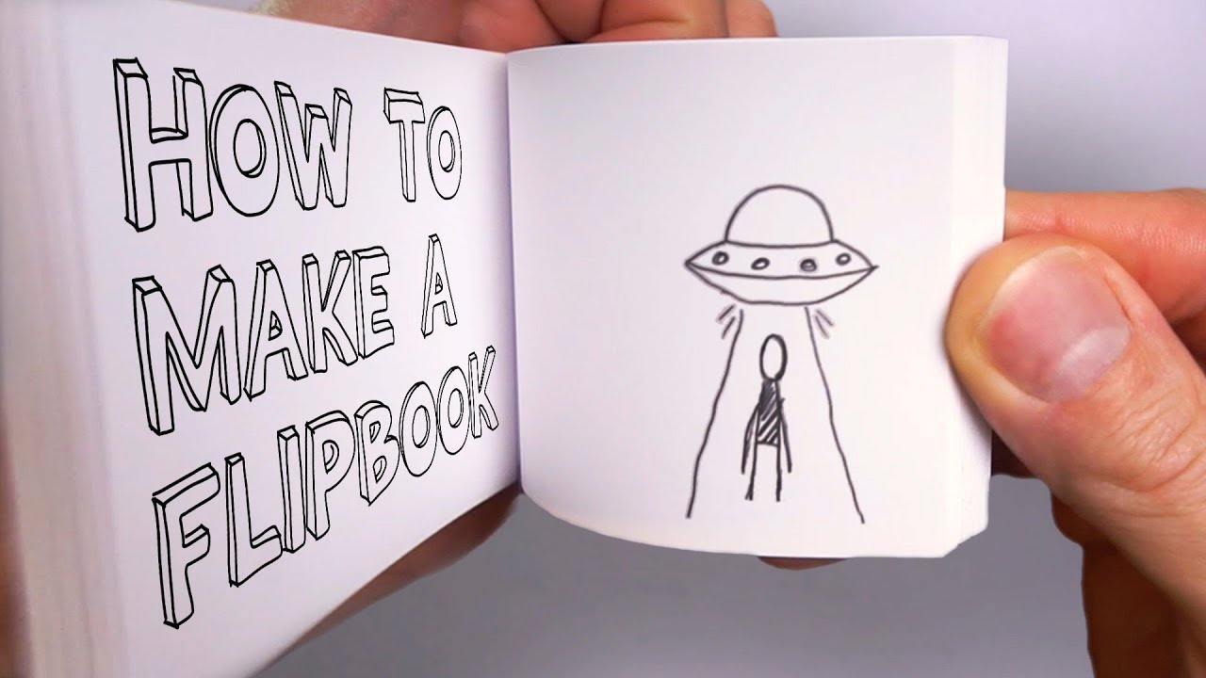
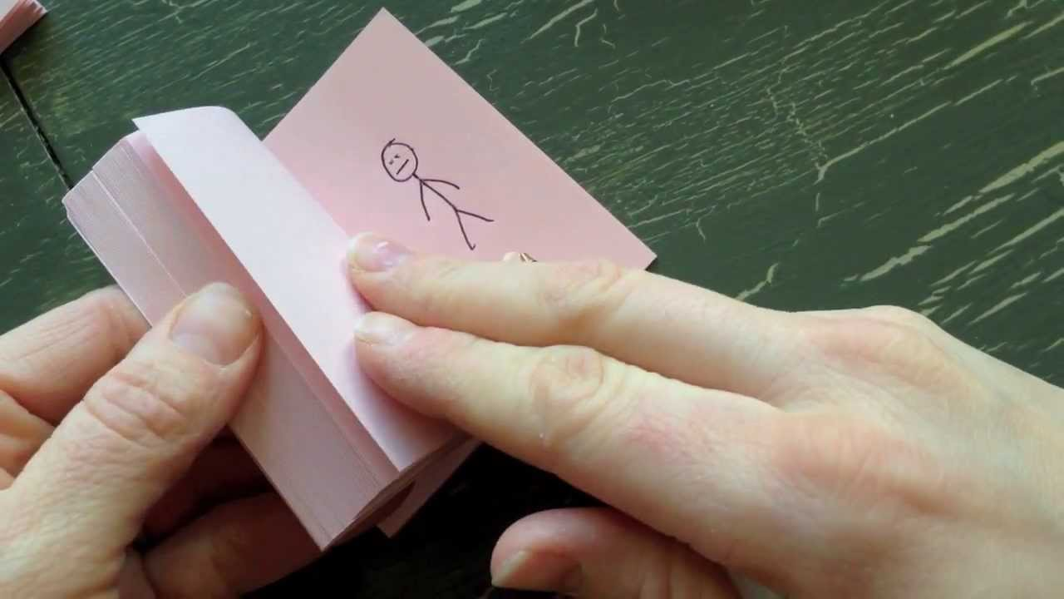
Recap from last week – What is Animation?
Animation is described as a ‘process by which we see still pictures move’.
How does this work?
Our brain holds onto an image for a fraction of a second after the image has passed. When our eyes see a series of images very quickly one after the other, because our eyes cannot cope with fast-moving images, they are tricked into thinking that the images are moving.
If the images you are seeing change in some way, you see this as animation.
So animation is actually just a set of still pictures moving very quickly!
The flick books you made last week show this.

Slide 3
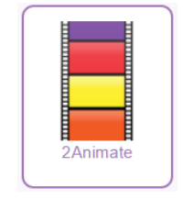
Most of the images for animations today are created using computers.
Today, you are going to use 2Animate on Purple Mash to create your own simple animation!
Find 2Animate in your Purple Mash 2Do list and open.

Slide 4

You are going to use 2Animate to create a series of frames, changing the picture in each of the frames.
Start with a simple face.
You can drag the first frame you draw onto Frame 2. This will copy the image so you don’t have to draw the same image on Frame 2. Add to the image and drag it to Frame 3, etc.

Slide 5


Click on the plus sign to add a frame if you need an additional one and the minus sign to delete one of the frames if you are not happy with the image.
Click on the green for ‘go’ arrow key at the top of the page to animate the frames.
Use the icons at the top of the page to speed up and slow down the animation or to pause and stop it and return to the previous screen.

Slide 6
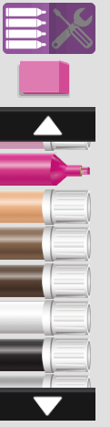
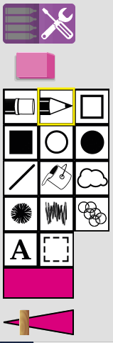

Challenges
Once you have tried a basic face, see if you can create a more adventurous animation.
Click on the tools icons to see more advanced
drawing options.
You could try adding a background picture or sound effect.
Remember to save your animations so that we can see them! Have fun ☺

