Slide 1
Computing : Animation
Tuesday 23rd February

Slide 2
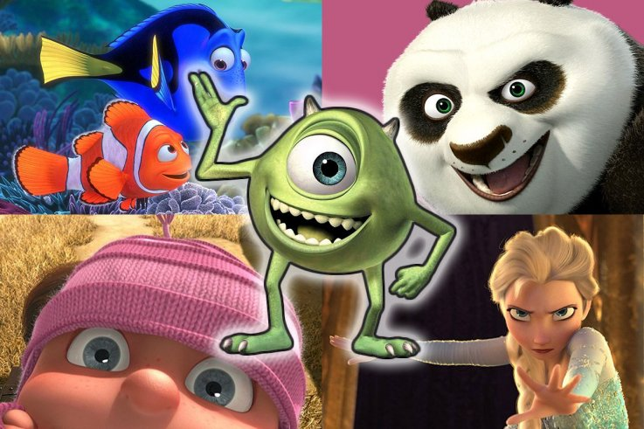
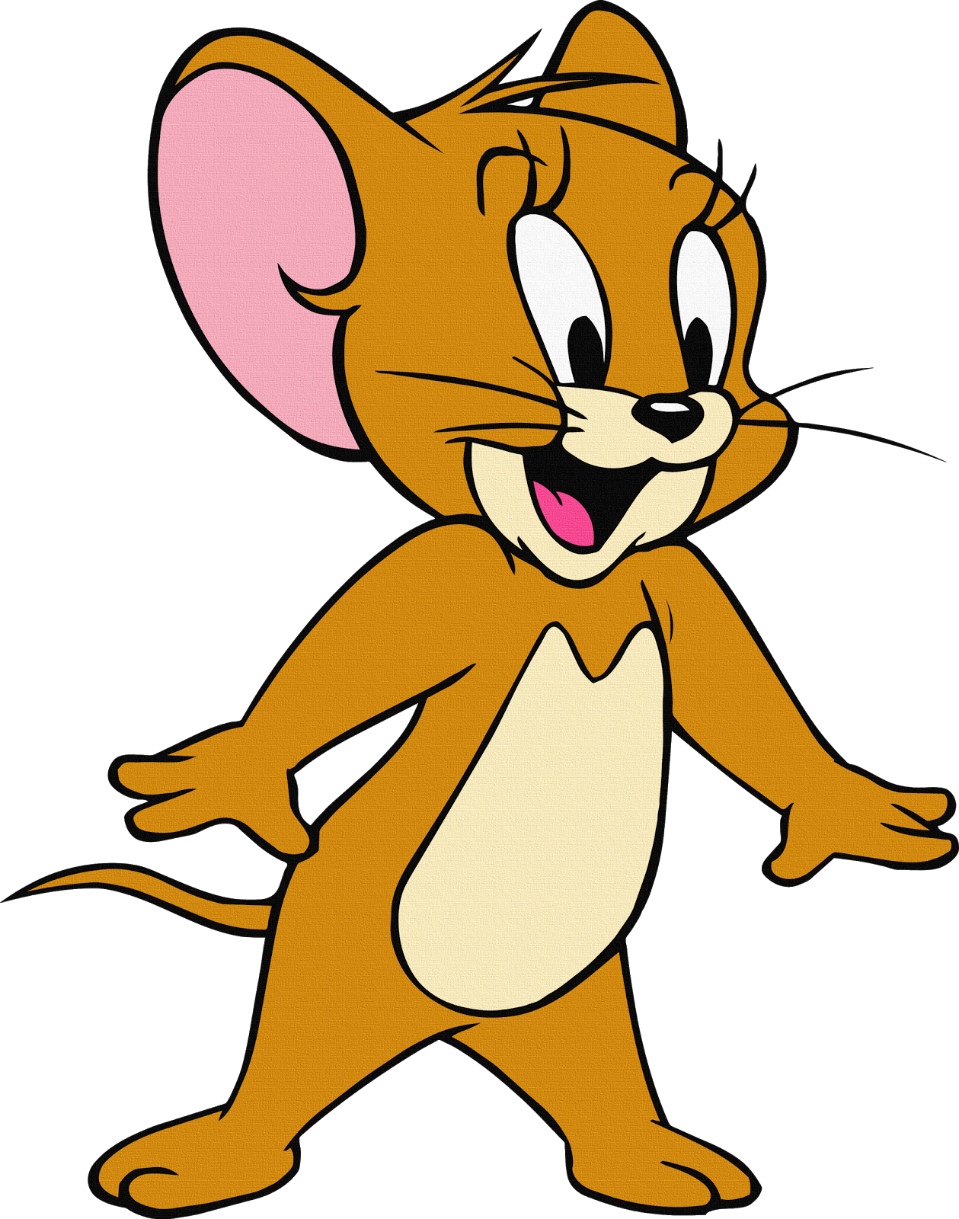
Here are some examples of animated films and cartoons.
Can you name any others?
What are your favourite animated cartoons and films?
Why are animated films and cartoons enjoyable to watch? Why can they sometimes be more fun than real images?

Slide 3
Animation can be something very simple and can start with simply animating a face so the character appears to smile when the animation is run.
Animation is described as a ‘process by which we see still pictures move’.
Each individual picture is shot on film one at a time. The pictures are shown at the rate of 24 pictures per second, which makes the pictures appear to move.

Slide 4
How does this work?
Our brain holds onto an image for a fraction of a second after the image has passed. When our eyes see a series of images very quickly one after the other, because our eyes cannot cope with fast-moving images, they are tricked into thinking that the images are moving.
If the images you are seeing change in some way, you see this as animation.
So animation is actually a set of still pictures moving very quickly!

Slide 5

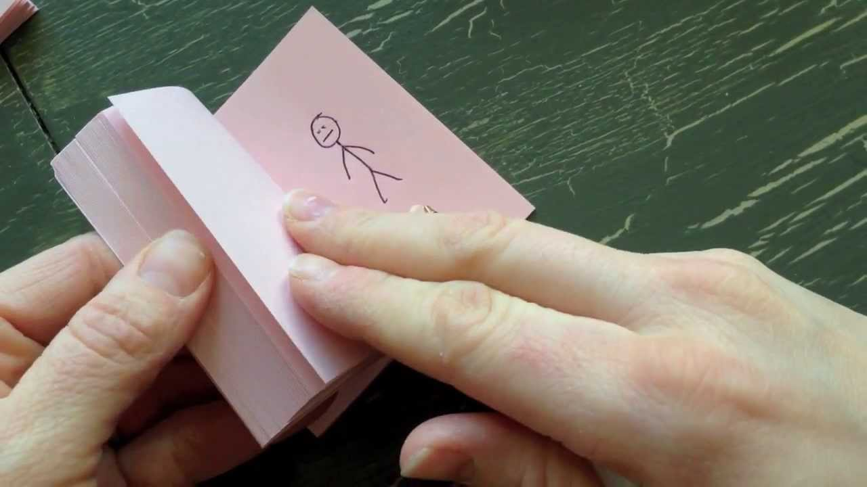
Flick Book Animation
Have you ever seen or used a flick book?
Watch this clip of some different flick book examples: https://www.youtube.com/watch?v=wEp3KprCkuk
Then watch this clip which shows you how to make a flipbook: https://www.youtube.com/watch?v=Un-BdBSOGKY

Slide 6
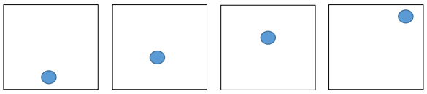
Your Challenge
Your challenge is to try and make your own very simple flick book.
You can try an animation similar to one in the clips or you can try this simple moving ball flick book.
1. You need some post-it notes or you can cut some squares of paper and fasten with a staple or paper clip.
2. Make a ball move by drawing it in different positions diagonally across several of the pages at the beginning of the post-it note pad.
3. Now flick the pages very quickly to see the image move!

Slide 7
Just for fun!
Watch the first animated film created by Walt Disney with synchronized sound, first released in 1928! https://www.youtube.com/watch?v=BBgghnQF6E4

