Slide 1
English:
The Mousehole Cat
Antonia Barber Nicola Bayley

Slide 2
For the next two weeks our English work will be based on the story ‘The Mousehole Cat’.

Slide 3

Tuesday 5th January
Introduce the story and look at the picture of the cover on the PowerPoint. What can you see? Make predictions about the story.

Slide 4
This story is a legend. A legend is a story that has some truth in it and this book is a retelling of the true story of Tom Bawcock which is commemorated every December in the village of Mousehole in Cornwall.
Look at where Mousehole is on the map and look at the pictures in the PowerPoint. Where is Mousehole? What sort of place is this? How might the geography of the area influence people’s lives? What might it be like to live there in the wintertime? Why do you think this?
Write a few paragraphs in full sentences, answering these questions.
(See pictures on the next slides or look for your own on the Internet!)

Slide 5
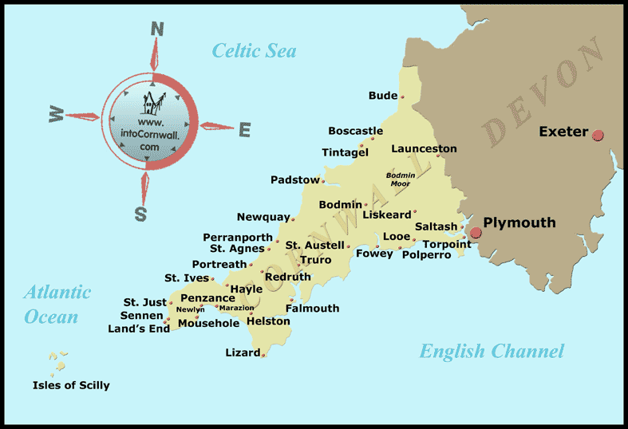
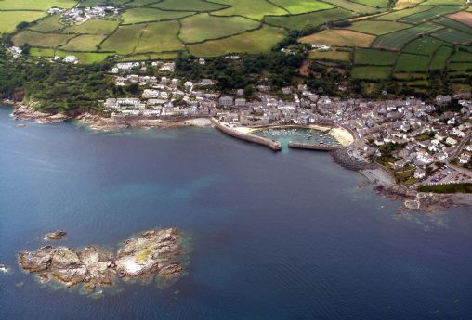
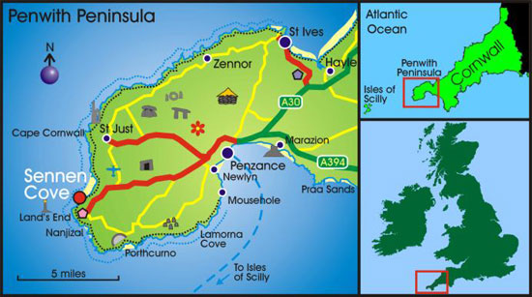
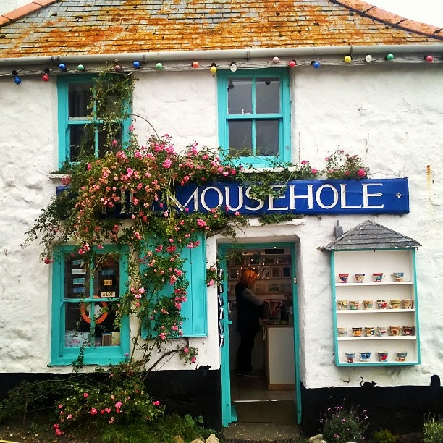

Slide 6
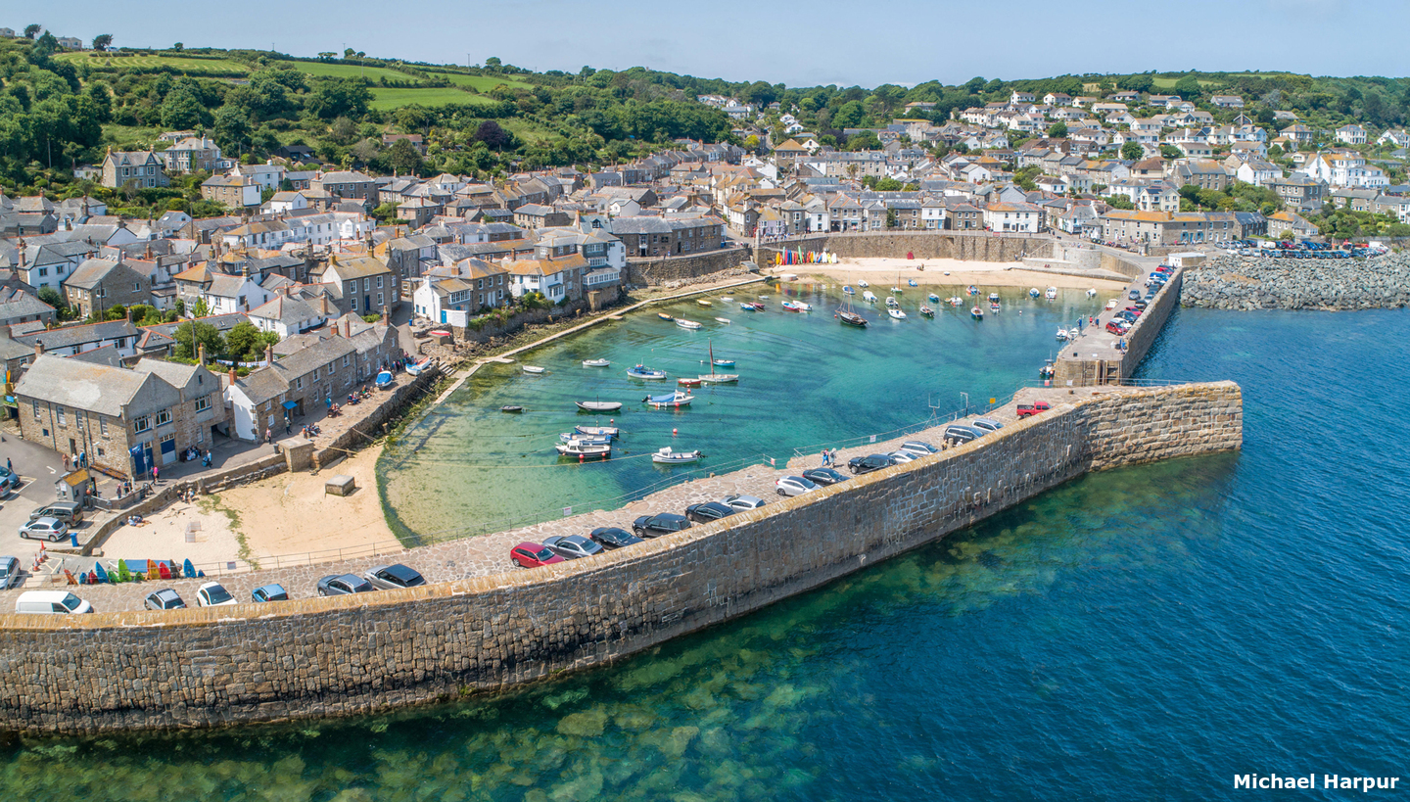
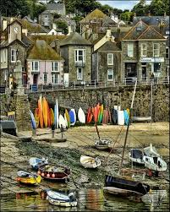
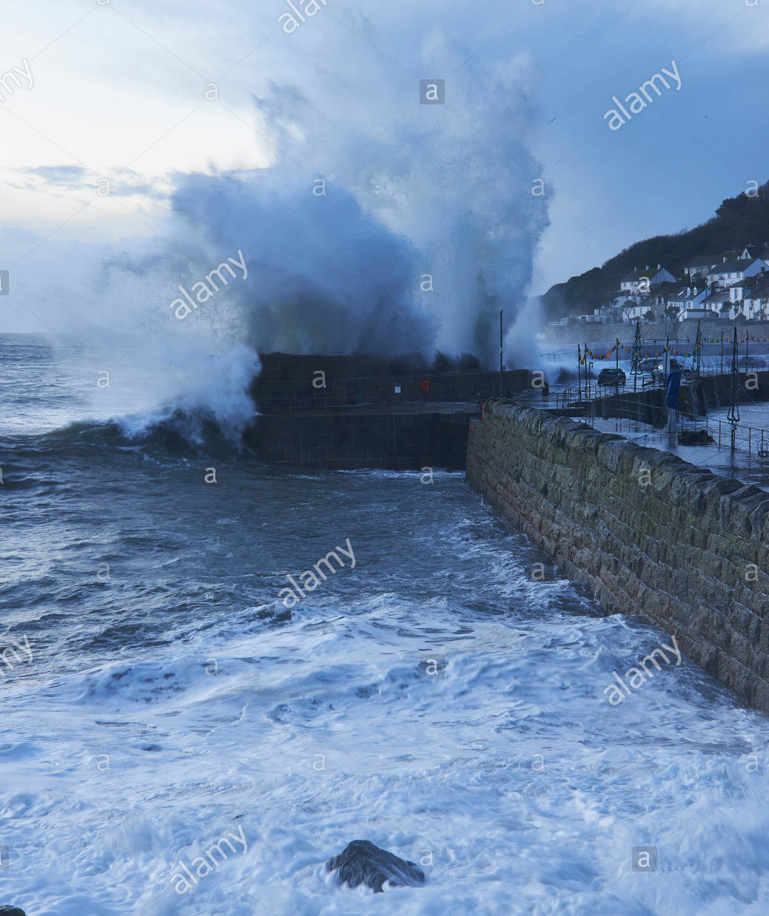
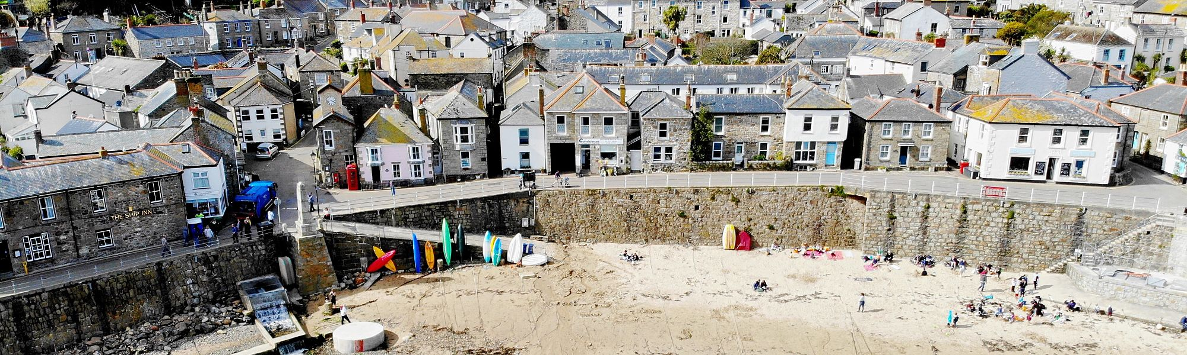

Slide 7
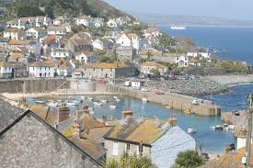
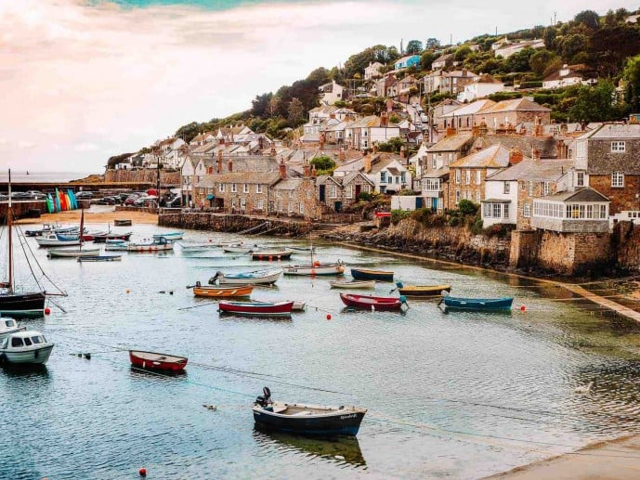
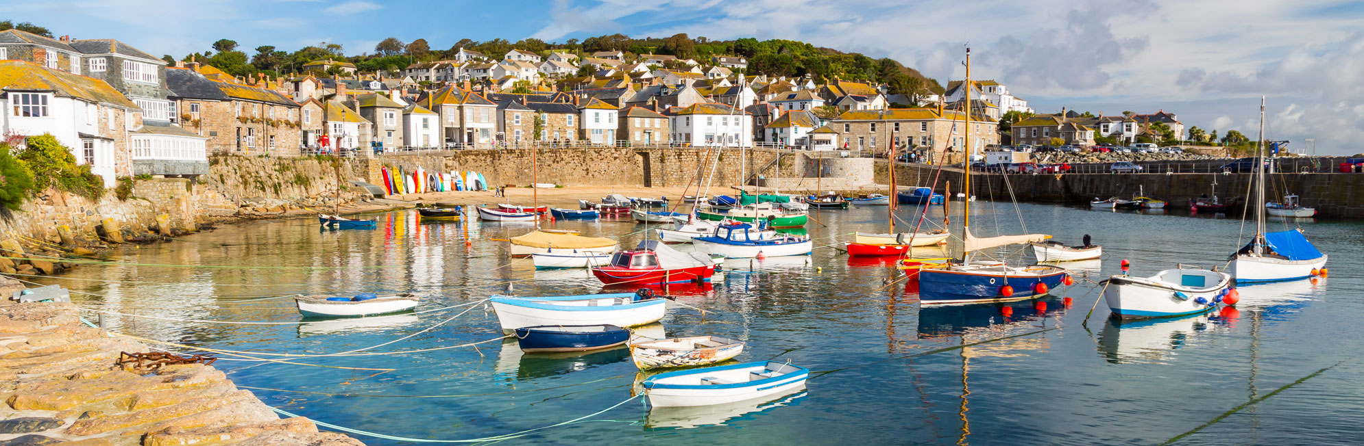

Slide 8
Wednesday 6th January
Either watch the clip of the story being told OR read the PDF copy of the story up to where the storm begins.
https://www.youtube.com/watch?v=3La59tdXs2U
Look at the picture of the storm arriving at the harbour wall. Look at it carefully and think about how you would describe it. What can you see? What does it remind you of? How do the fishermen feel in their boats? What words or phrases does the writer use to show the fierceness of the storm? Personification is when a writer gives something human or life-like qualities. Can you find any examples on this page?
Write a short description of the storm using interesting adjectives, verbs and adverbs. Remember full stops and capital letters. Try to extend some of your sentences using conjunctions.

Slide 9
Thursday 7th January
Finish watching the rest of the story on Youtube https://www.youtube.com/watch?v=3La59tdXs2U or read the rest of the book from the PDF.
Start to draw a story map of the story (on A4 paper is fine but A3 would give you more space!), identifying the main events, characters and places. Remember your story map can be simple ‘stick’ pictures with arrows to the next main event, please do not spend time on detailed drawing and colouring. Instead, try to focus on remembering the important key events and annotating with the speech and thought bubbles for the characters. The aim of the story map is to help you remember and re-tell the story in your own words.
This will be continued tomorrow.

Slide 10
Friday 8th January
Re-read your story map from yesterday and then complete it today.
Once you have completed your story map, re-tell the story to a grown up using your story map to help you. Have you remembered the main details of the story?

Slide 11
Well done for trying so hard on all of your English work! We hope you have enjoyed the story.
Next week we will continue our work on ‘The Mousehole Cat’. ☺

