Slide 1
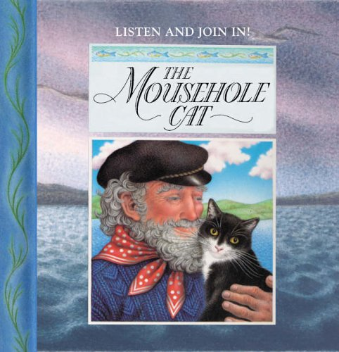
English:
The Mousehole Cat
Antonia Barber Nicola Bayley

Slide 2
This is the final week of our English work based on the story ‘The Mousehole Cat’.

Slide 3
Monday 11th January
Look at the picture of the boat being tossed about at sea within the paws of the Storm-Cat (on the next slide).
You may also find it useful to re-read the story from ‘Now she lifted her head and sang like a siren, joining her call with the cry of the Great Storm-Cat’ up to ‘Then the Great Storm-Cat began to purr with Mowzer, and as the soft sound grew, the winds waned and the waves weakened’ on the PDF or listen to this part 7.20 - 10.46 on the YouTube clip.
https://www.youtube.com/watch?v=3La59tdXs2U

Slide 4
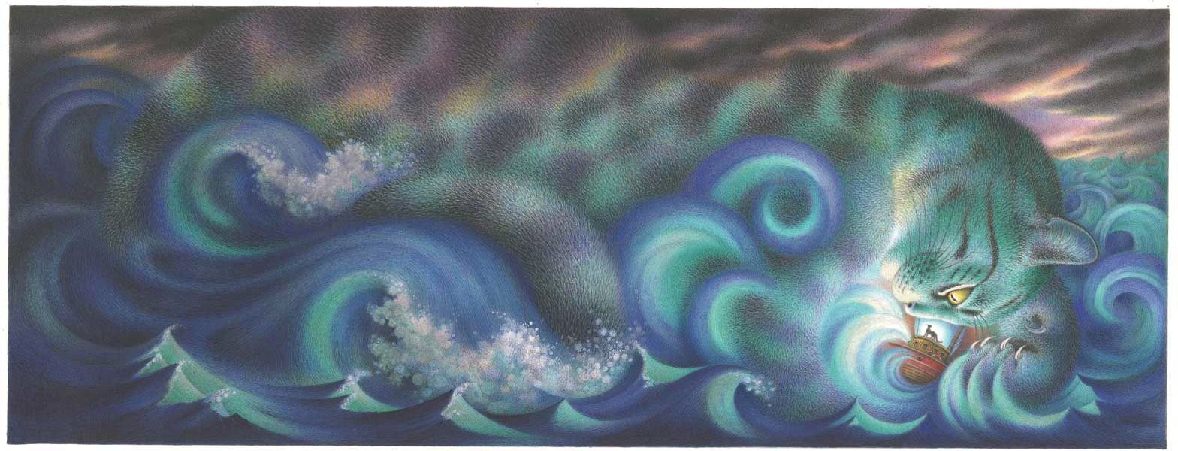

Slide 5
Imagine that you are Mowzer the cat, on the boat in the middle of the storm. What can you hear? What can you see? How does it make you feel? How would you describe the water? The boat? The sky? The storm/Storm-Cat? When Mowzer ‘sings’ to the Storm-Cat, what might she be saying? What might she be saying to calm the storm?
Brainstorm your ideas on paper. Try to include adventurous adjectives, verbs and adverbs. For example, rather than just writing ‘loud’ wind you might improve that with ‘howling’ wind.

Slide 6
Tuesday 12th January
Look again at the picture of the boat being tossed about at sea within the paws of the Storm-Cat and re-read your ideas from yesterday.

Slide 7
In the grip of the storm Mowzer begins to ‘sing’ to the Storm-Cat and calms it, allowing Tom to catch the fish and the boat to return safely to the harbour.
You are going to use your ideas from yesterday to imagine you are Mowzer and write ‘Mowzer’s Song’, in other words, a poem from Mowzer to the Storm-Cat.
What is she saying to the Storm-Cat about the storm and how it feels to be on the boat?
What is she saying to calm the Storm-Cat? For example, in the book it says ‘Mowzer felt a sudden strange sadness for him. How lonely it must be, she thought, endlessly hunting the men-mice in the deeps of darkness, and never returning to the rosy glow of a red-hot range’. Does she try to comfort him? Persuade him he is not alone?

Slide 8
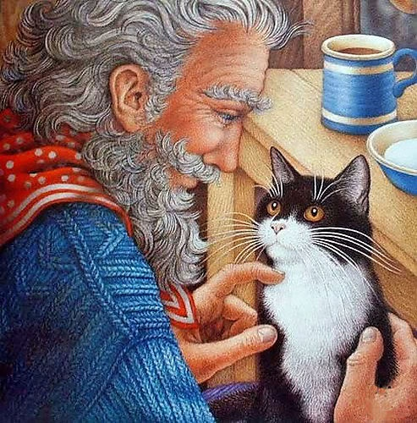
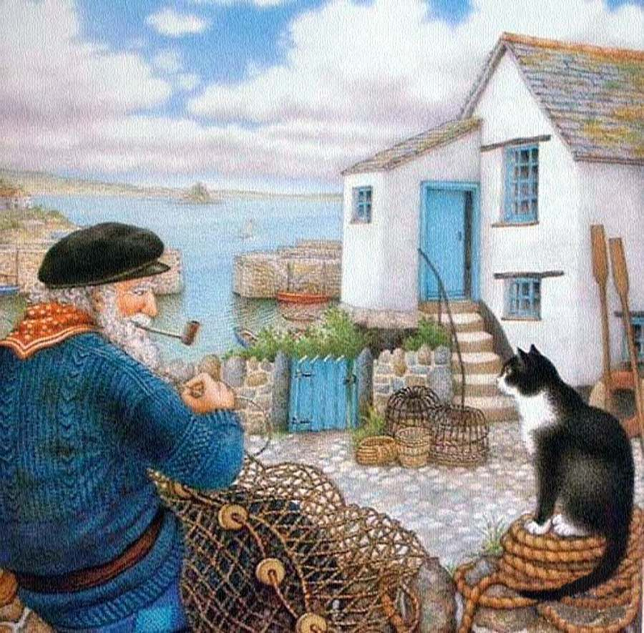
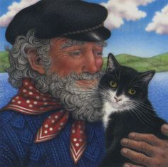
Wednesday 13th January
From whose point of view is the story told? How do you know? Do you think Tom would tell the same story as Mowzer? Today we are going to think more about the character of Tom.
Draw a small picture of Tom in the middle of your page. Then write down everything you think you know about him around your picture. If you are giving your opinions, can you explain some of your ideas by referring to the text. For example, ‘I think he ____ because in the story it says______’.

Slide 9
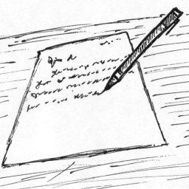
Thursday 14th January
You are going to use your ideas from yesterday to help you write in role as Tom.
Imagine that you are Tom at the very end of the story, having just returned to the harbour. Write a letter to your friend, telling them about the events that have happened and about your special cat Mowzer.
You might include paragraphs about:
Why you decided to go fishing even though you knew it was dangerous.
What it was like being on the boat in the storm.
How your special cat Mowzer helped you.
What and who you saw when you returned to the harbour that night.
How the village celebrated and how you felt knowing you had helped everyone.
Remember to set out your writing like a letter. Check your sentences make sense and you have used full stops and capital letters. Exclamation marks and question marks used correctly would also help make your writing interesting.

Slide 10

Friday 15th January
We have finished our work on ‘The Mousehole Cat’! We hope you have enjoyed the story.
Today you are writing a book review of the story. We would like you to explain:
Who are the main characters and where is the story set?
What did you like about the story? What was your favourite part and why?
Which are your favourite illustrations and why?
Is there anything you did not enjoy about the story and why?
Who would you recommend the story to and why?

Slide 11
Well done for trying so hard on all of your English work again this week! We hope you enjoyed the story. ☺

