Slide 1

Poetry Week
Tuesday 23rd February – Friday 26th February
This week we are going to explore poems with different structures, write our own poems and then complete the week by sharing some poetry from the author and poet Michael Rosen. We hope you enjoy it!

Slide 2
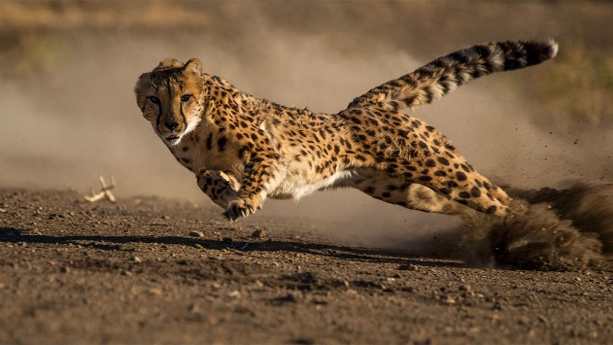
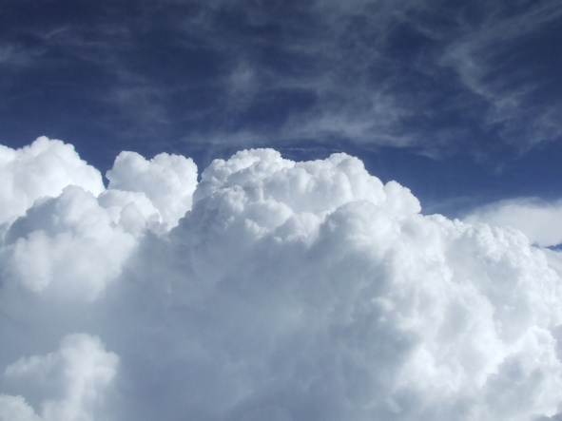
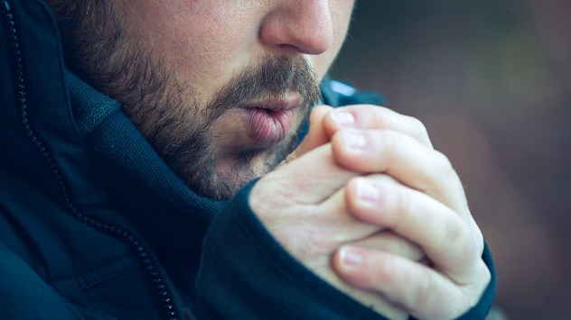
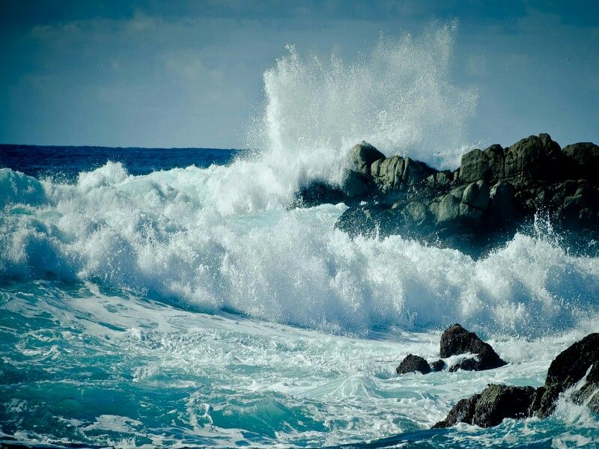
Tuesday 23rd February – Animal Poems
Many poets use simile in their poems to make their descriptions more interesting. A simile is when one thing is compared to another thing that has similar characteristics, using the words ‘like’ or ‘as’.
For example:
The girl ran as fast as a cheetah.
The clouds were white and wispy like cotton wool.
My fingers are as cold as ice.
Waves crashed on the rocks like thunder.

Slide 3
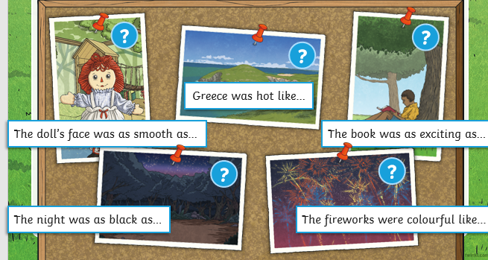
Poetry Warm-Up
Can you think of some similes for these examples? Say them out loud.

Slide 4
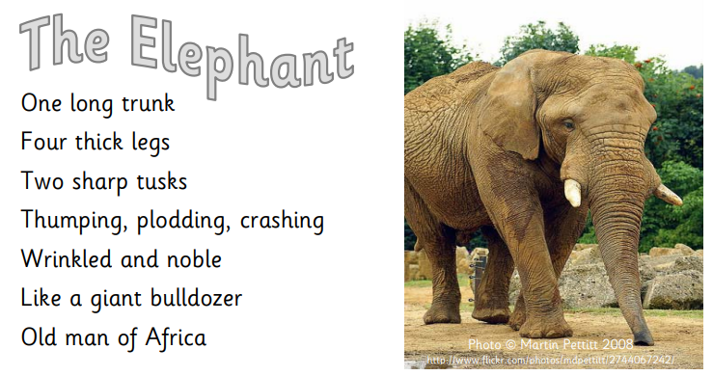
Animal Poems
Read the following poem about an elephant.

Slide 5
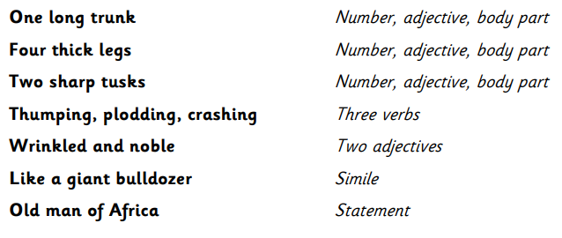
The poem has a clear structure and pattern.

Slide 6
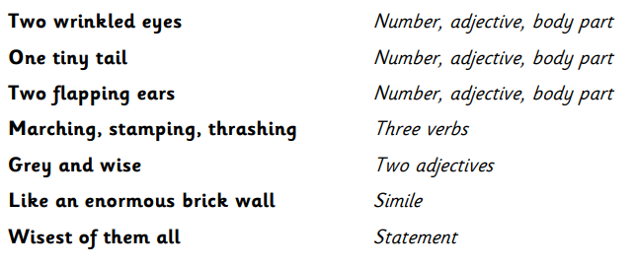
Now read this elephant poem, an alternative version following the same pattern. Can you see how this poem follows the same structure?

Slide 7
Your task is to write a poem about an animal of your choice, following the same structure as the elephant poems.
You might find it useful to look at some pictures of your animal before you start, in a book or on the Internet. Jot down the names for the different parts of the animal and words to describe that part, so that you have some ideas before you start writing. For example, ‘razor-sharp tusks’.
Remember to:
Use adventurous adjectives – describing words
Use interesting verbs – doing and being words
Include a descriptive simile - use ‘like’ or ‘as’ to compare your animal to something else.
Read through, check and edit your poem. Have you repeated any words? Could you use a thesaurus to improve your vocabulary? https://kidthesaurus.com/ Have you followed the structure of the original poems?
You need to have one of the elephant poems in front of you so that you can follow the same pattern for each line of the poem.
So, what animal will you choose?!

Slide 8
Wednesday 24th February – Kennings Poems
Kennings poems are like riddles. They describe something without ever saying what it is.
Read these Kennings poems. What could they be about?
Look at the next slide to see if you guessed correctly!
Lip – licking
Chin – dripping
Sauce – swirling
Cone – filling
Flake – holding
Tongue - freezing
Tail - wagger
Face - licker
Ball - catcher
Cat – chaser
Park – runner
Bone – chewer

Slide 9
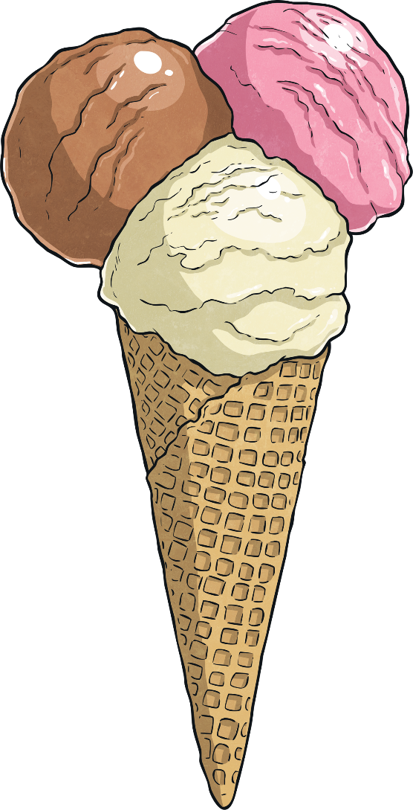
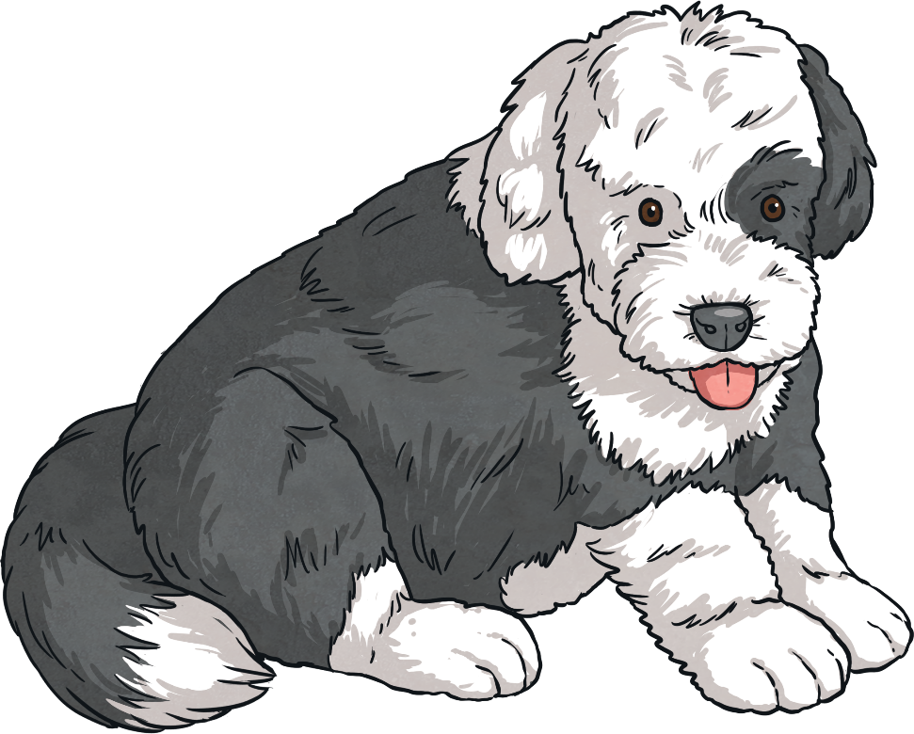
Could you work out what the poems were about?
What do you notice about the poems?
Each line of the poem is made of a two-word phrase.
The words are joined
by a hyphen.
Lip – licking
Chin – dripping
Sauce – swirling
Cone – filling
Flake – holding
Tongue - freezing
Tail - wagger
Face - licker
Ball - catcher
Cat – chaser
Park – runner
Bone – chewer
Here the phrases are made up of a noun + a verb (the verb usually ends in -ing).
Here the phrases
are made up of
a noun + a noun.

Slide 10
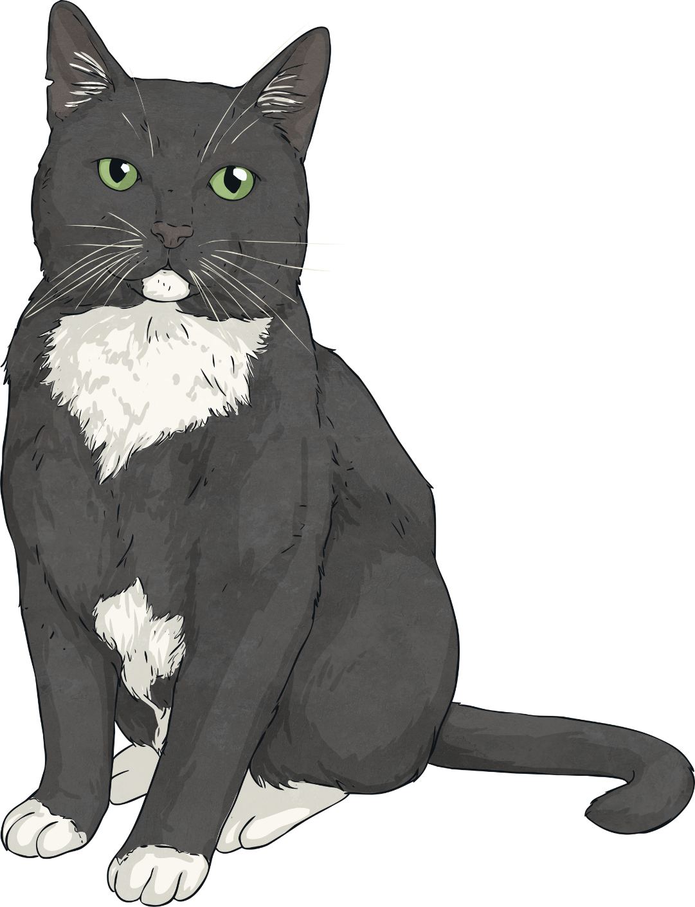
Here is another example for a cat.
Can you think of any other phrases you could add for a cat?
mouse-hunter
milk-drinker
night-stalker
fur-licker
ankle-rubber
dog-hater
nose-nuzzler
ear-scratcher
loud-purrer

Slide 11
Your task is to write a Kennings poem about yourself.
First, brainstorm lots of words and phrases about you. This could include your favourite food, hobbies, subjects at school, your personality, things you like to do – anything about you!
Here is an example: Like hugging friends Read books
Eat chocolate Drink tea
Hate spiders Love the sunshine Play football
Me

Slide 12
2) To start creating your Kenning, try and make a noun + noun phrase or
a noun + verb phrase using your words. Don’t forget the hyphens!
Here is an example:
Like hugging friends Read books
Friend-hugger Book-reader
Eat chocolate Drink tea
Chocolate chomper Tea-drinker
Hate spiders Love the sunshine Play football
Spider-hater Sunshine-lover Football-kicker
Me

Slide 13
3) Now put your two-word phrases together.
Friend-hugger
Book-reader
Football-kicker
Chocolate chomper
Tea-drinker
Spider-hater
Sunshine-lover
Read through your poem. Check your spelling and punctuation.
Could you improve any of the vocabulary? For example, could you add some alliteration (where words start with the same sound like ‘chocolate chomper’?)

Slide 14
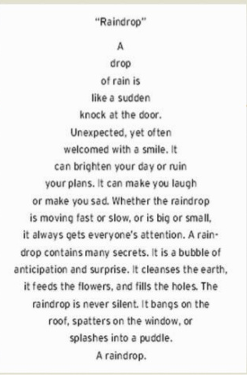
Thursday 25th February – Shape Poems
A shape poem is a poem that describes an object, person or animal.
The special thing about a shape poem is that the words of the poem form the shape of the object, person or animal being described.
Shape poems can use full stops and capital letters like sentences.
Shape poems don’t have to rhyme!
Shape poems often use alliteration or similes.

Slide 15
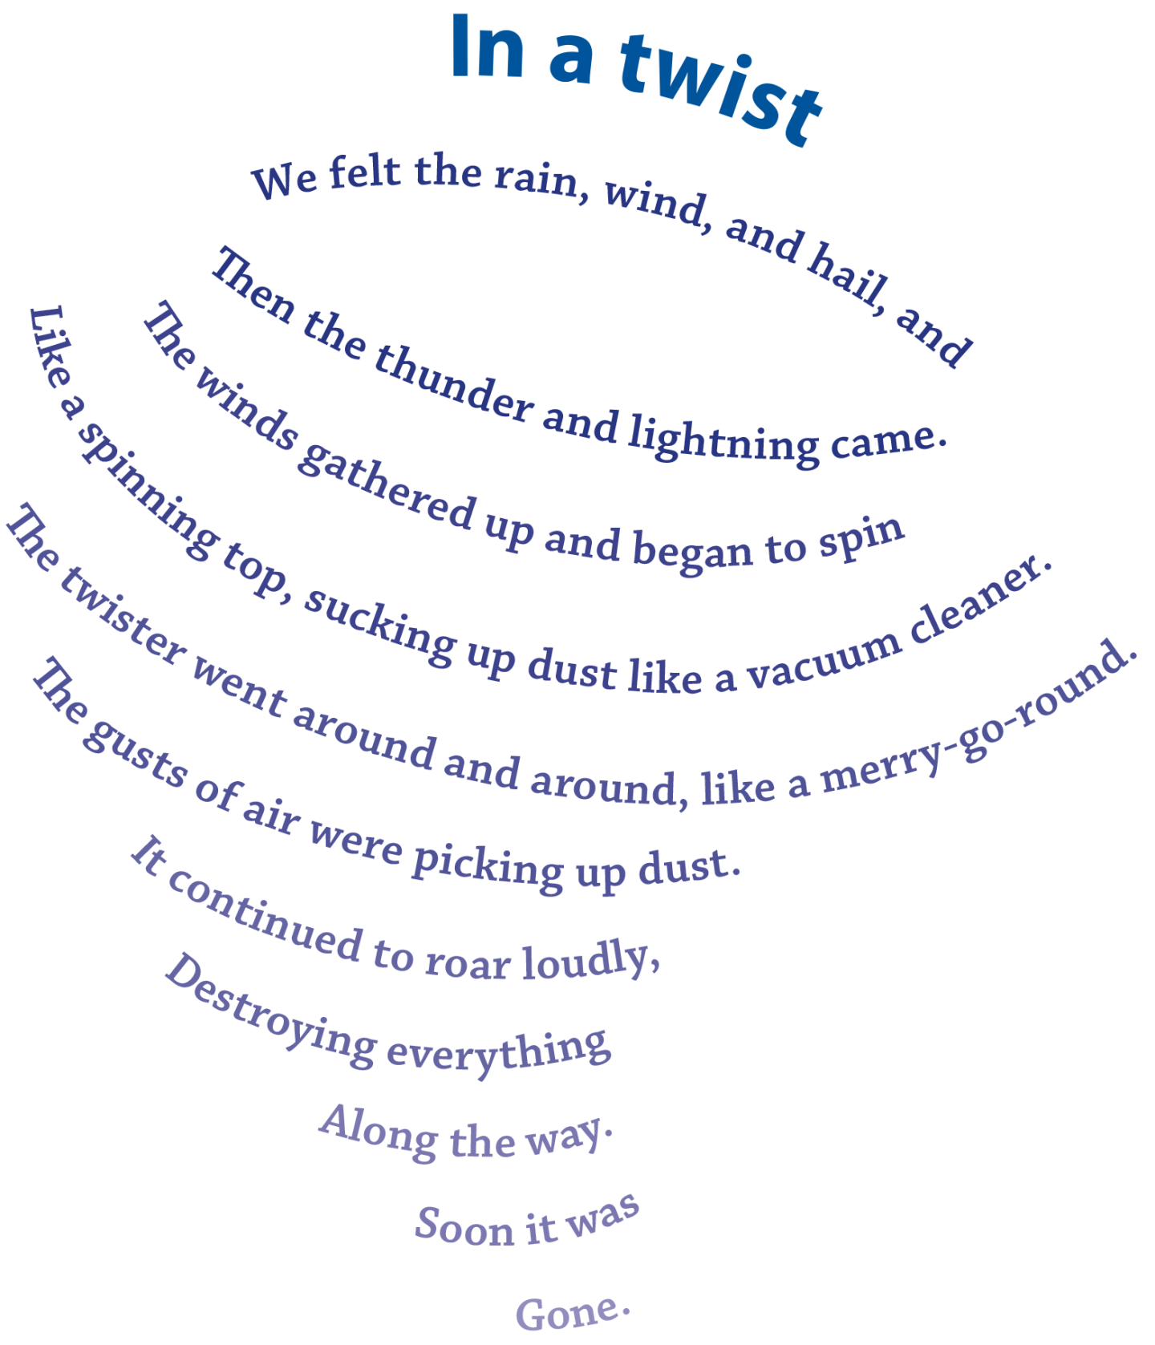
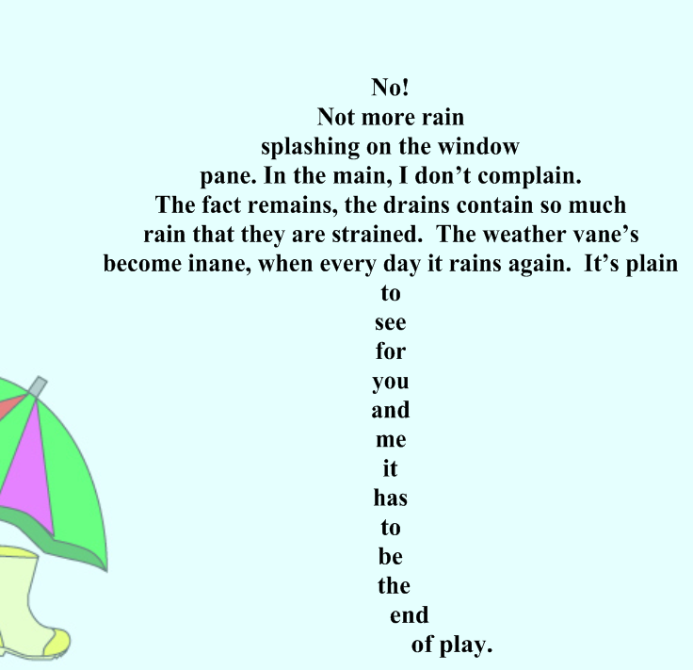

Slide 16
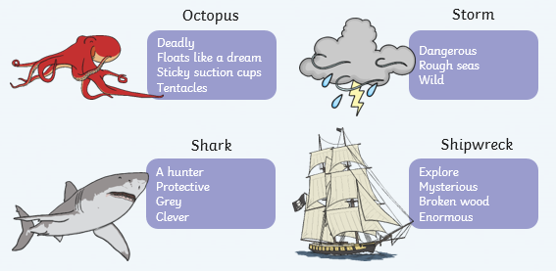
Your task is to write a shape poem about an object or animal you would find in the ocean.
First you need to think of lots of adjectives or phrases to describe what you have chosen.

Slide 17
Using your ideas, create your shape poem. You can use one of the templates from Dojo (boat, shark, seahorse, fish, turtle, stingray) or create your own.
Similes can be used – this is where we use the words ‘like’ or ‘as’ to compare two things to each other.
Remember to stay inside the lines of the picture, starting a new line when you get close to the edge.
Don’t forget to use full stops and capital letters.
Try to use alliteration or similes if you can; this will make your shape poem more exciting and descriptive.
Alliteration can be used – this is lots of words
in a row beginning with the same letter.
Each line can be a different length or be curved to form the shape of the object that is being described.
Full stops and capital letters can be used just like you would use in sentences.
The lines don’t have to rhyme.

Slide 18
Friday 26th February – Michael Rosen
Michael Rosen is a famous British poet. You may have heard of him before or know some of his poems.
https://www.bbc.co.uk/teach/school-radio/english-ks2-michael-rosen-talking-poetry/zn37rj6
Watch this clip (approx. 15 minutes)
Which poem did you like best?

Slide 19
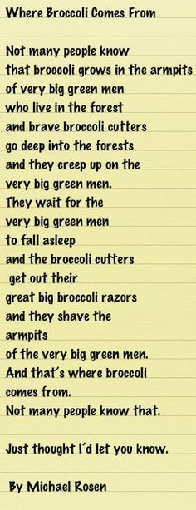
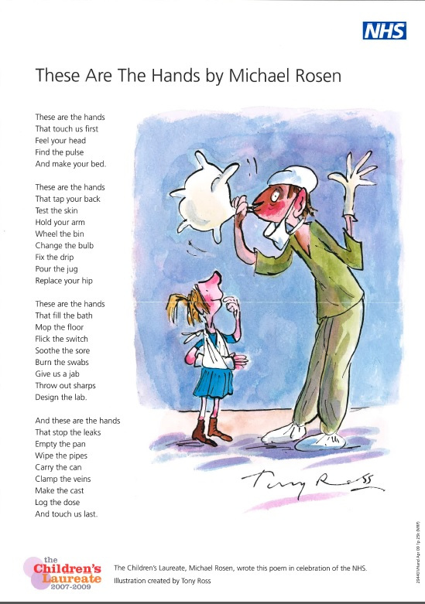

Slide 20
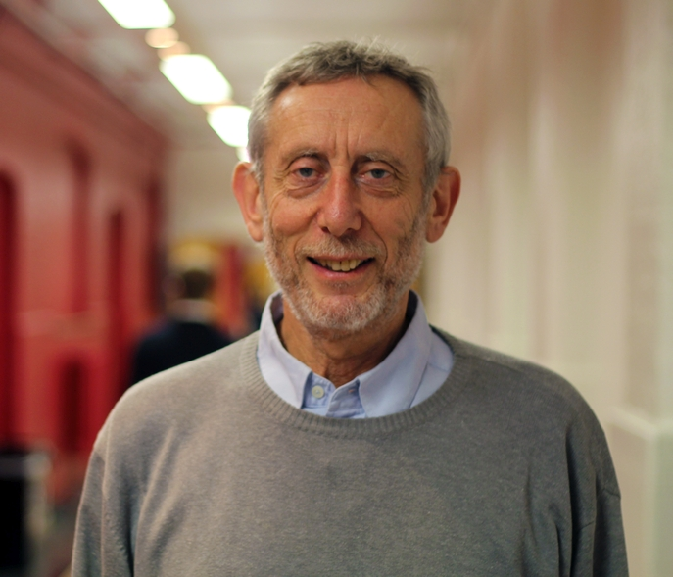
Michael Rosen also has his own YouTube channel where you can watch him perform some more of his poems.
https://www.youtube.com/MichaelRosenOfficial
And his own website where you can find out more about him and his life.
https://www.michaelrosen.co.uk
You can also listen to some of his poems here
https://poetryarchive.org/poet/michael-rosen/

Slide 21
Your task…
Find out at least 5 interesting facts about Michael Rosen and write them out neatly in your own words.
Listen to, read or watch a selection of Michael Rosen poems. What do you like about them? Choose one or two of your favourites and write a paragraph explaining why you like them.
Choose one of Michael Rosen’s poems and have a go at performing it!
This video might help you….
https://www.youtube.com/watch?v=RvV23xoZRkI
Perform the poem to someone in your family or upload a video of yourself performing your chosen poem to Class Dojo.

