Slide 1
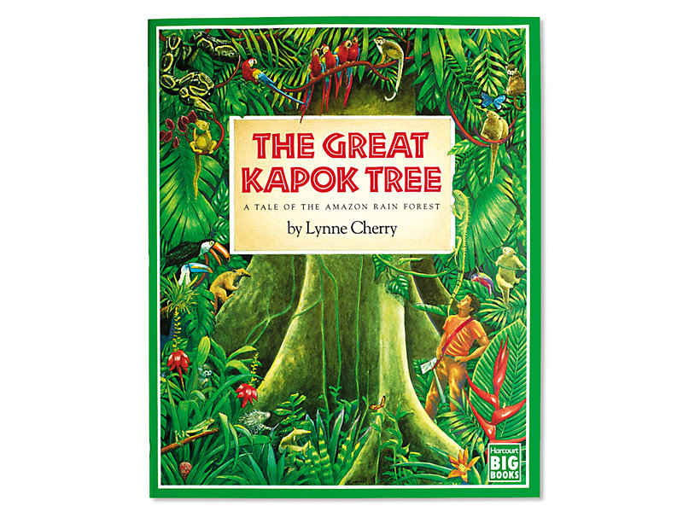
The Great Kapok Tree
The Tale of the Amazon Rain forest
By Lynne Cherry
Week 2

Slide 2
Monday 25th January
Re-read the story as you have had the weekend and might have forgotten the key parts. Choose one of the animals from the story. Think of some reasons of what they would say to the men to get them to change their minds. What words could persuade them? Think of at least three to four really good reasons.
Look at the persuasive word mat to help you with your writing. How might they be thinking and feeling? How can you put that feeing into your ideas so that the men will really listen?
This is an example, I chose the bee.

Slide 3
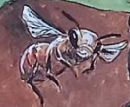
I beg you to listen. I may be small, but I am very important within this ecosystem. My hive and home are within this mighty tree and if you chop it down there will be devastating consequences for everyone! You see, I pollinate the trees and the flowers, so without me and the other bees there would be no more flowers or trees. I urge you to reconsider your decision and think about the impact that cutting down the tree would cause. I suggest you think carefully before you act. This is not just my home, but is the lifeline of the whole ecosystem. We would be lost and even worse, we will not survive without it.

Slide 4
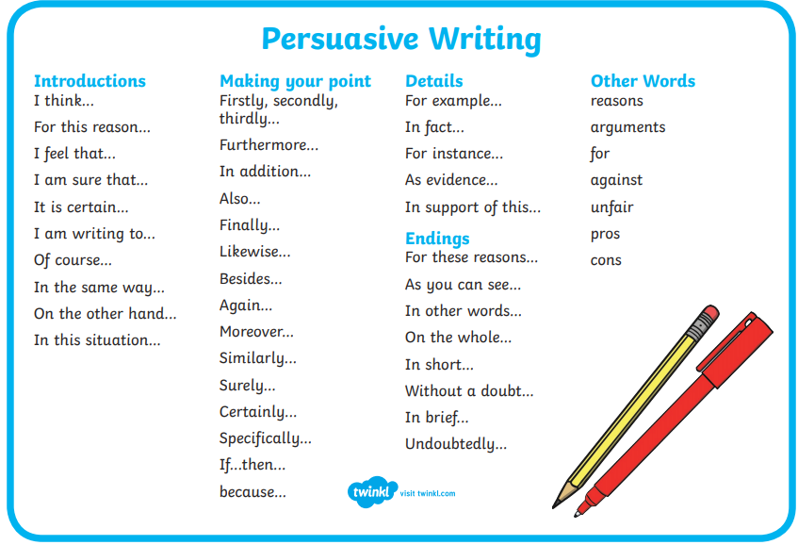

Slide 5
Tuesday 26th January
Watch the video: https://www.bbc.co.uk/news/education-13784999
After you have watched the video think about the harmful effects that logging has on the environment and the local area. Now think about the some of the benefits of logging that it may bring to the local community.
Use a table to list them, like the one below.
Harmful effects of logging | Benefits of logging
The article below the video on the web page has some more ideas to support your writing today.

Slide 6
Wednesday 27th January
Read the whole book again. Reflect on the ending of the story and think about the following questions.
What did the man do?
Why do you think he did this?
What do you think will happen next?
Pretend that the smaller man is now going to go back to the larger man. What do you think will happen when he returns? What will they say to each other? How will they react to each other in this situation? What will the larger man’s concerns be? How will the smaller man justify his actions? How will the larger man respond?
Try to write out a conversation that they would have. You can present the conversation how you wish. So, you might want to use speech bubbles for each man or you could write out a line by line conversation between them. Get creative with your conversations. You could role play your conversations with an adult too?

Slide 7
Thursday 28th January
Today we are going to plan a fact file about the Rainforest. This could be one page of A4 or you can make a little book. You can decide how you present your work.
What main title will your fact page have?
What subheadings will your fact page have? Maybe you could write about where the Rainforests of the world are, you could write about the animals found there, the trees, protecting the rainforest, what impact logging has or the benefits of logging.
Remember today is just a rough draft, using the time to research your facts and gathering your information.

Slide 8
Friday 29th January
Today you are going to write the final draft of your fact file about Rainforests. You need to oraginse your ideas and group them together so that you can easily read them. Use your best presentation skills and make it bright and colourful. You could even write a double page spread. This is where you use two pages of lined paper to spread the information out. You can add fact boxes, pictures, captions and subheadings.
Here are a few examples of how you might want to present your ideas.

Slide 9
