Slide 1
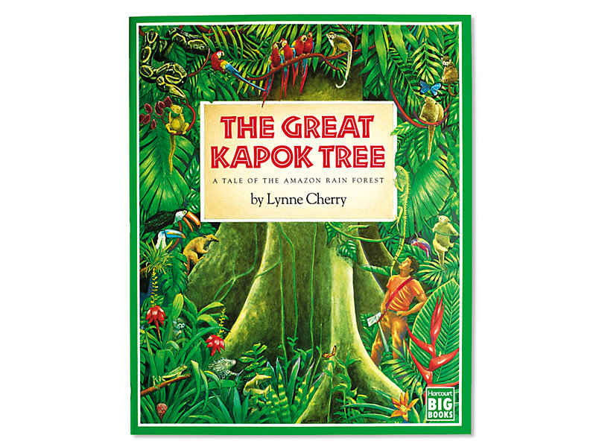
The Great Kapok Tree
The Tale of the Amazon Rain forest
By Lynne Cherry

Slide 2
Monday 18th January
DO NOT READ THE WHOLE BOOK YET, WAIT UNTIL YOU ARE DIRECTED TO SO IT DOESN’T SPOIL THE SUSPENCE.
Read the introductory page of the book (on the next slide)
Let’s have a think about what we already know about Rainforests. From our work in topic and what we have read before.
Can you create a grid to jot down your ideas and oragnise your thoughts? You can add to it as we work through the week. A template of this grid is on the website.
What I already know about Rain forests | What I want to find out about Rainforests. | Where might I go to find out more about Rainforests.

Slide 3
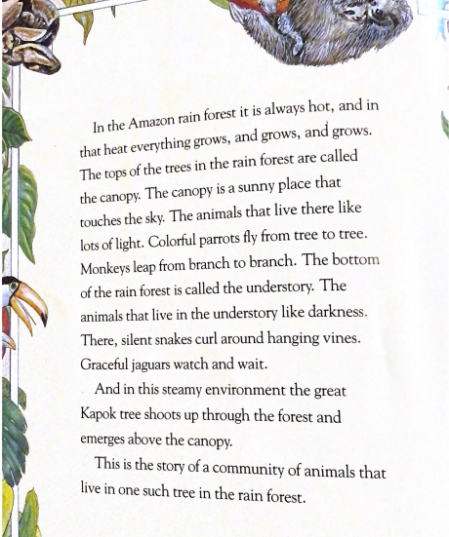

Slide 4
Think about the questions:
Why do you think this ecosystem is here? Where is the Amazon Rainforest located in the World? Why?
Watch the following video https://www.youtube.com/watch?v=3vijLre760w
Then view this video specifically about the Amazon Rainforest https://www.youtube.com/watch?v=5IzzogrKo6k
Can you add to your knowledge grid?

Slide 5
Tuesday 19th January
Setting description
After watching the You Tube videos and thinking about what a Rainforest is, today we would like you write a setting description.
First, watch the first 4 minutes of this video: Rainforest Beneath the Canopy - YouTube - YouTube
Now watch for a second time. Whilst you watch it can you note down any powerful words or phrases used to describe the setting?
Such as:
Huge trees stand like monuments
Amist the symphony of life
Outliving the dinosaurs
These words and phrases tell us that the Rainforest is strong, powerful and ancient.

Slide 6
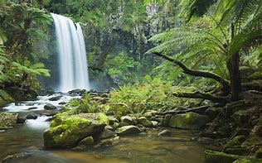
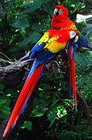
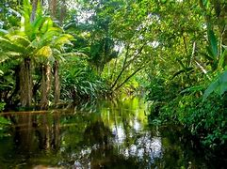
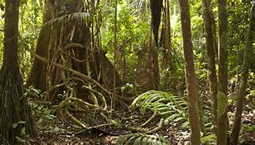
Look at the images of the Rainforest and describe it using powerful words and phrases. You are allowed to magpie from the videos. Make sure that your sentences make sense and that you have used capital letters and full stops. You could also use paragraphs to organise your ideas.

Slide 7
Wednesday 20th January
Read the first page of the book aloud. Answer the following questions in full sentences.
What do you like and dislike about what you see on the first page of the text?
Does it remind you of anything in real life or stories that you might have read before?
Do you have any questions about it? Does any thing puzzle you?
Who are the two men in the Rain Forest? What are they doing?
Write a prediction about what you think will happen in the text. Do not peek!
Once you have written your prediction down, read page 2 of the text. Were your predictions correct? Why do you think the men might be chopping down the tree? What impact will that have on the forest. Discuss with an adult or jot down your thoughts. Add any information into your knowledge grid from Monday.

Slide 8
Thursday 21st January
Think about standing in the Rainforest. What sounds might you hear? Play the following sound clip Rainforest Ambience Sounds | Effects | Sound Bites | Sound Clips from SoundBible.com
What sounds can you pick out? Animals, wind, trees.
Write a list of what you might hear.
Example:
Water flowing
Howling monkeys
Crickets chirping
After you have written your list, add words and phrases and try to construct a poem.

Slide 9
The title could be Rainforest Sounds, The Mighty Rainforest or make up your own. I have tried to write the beginning of a poem to give you some ideas……
Sounds of the Rainforest
Deep in the thick of the forest, it is alive with extraordinary sounds
Water drips, drips, drips from the leaves.
Howling monkeys call their young.
Crickets chirp in time, like a choir.
You could either write your poem down or record it in a performance.

Slide 10
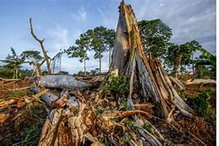
Friday 22nd January
Re-read page 1 and 2 of the text and think about the flowing questions……
Why do you think the man is cutting down tree?
What impact do you think this will have on the ecosystem?
Watch this video about deforestation. SOS Schools Pack Part 2: Deforestation - YouTube
Take each of the headings below and write a short paragraph about it. What does it mean? What is happening? Why does it happen? What is the impact?

