Slide 1
This PowerPoint Presentation contains links to external websites. Please check that the content of external links is appropriate for the intended audience. Twinkl Ltd is not responsible for the content of external links.

Slide 3
Aim
To find out about the Qur’an.
Success Criteria
I can explain what the Qur’an is, what can be found inside, why it is so special and how the book is treated by Muslims.
I can write about something that is special to me and why.

Slide 4
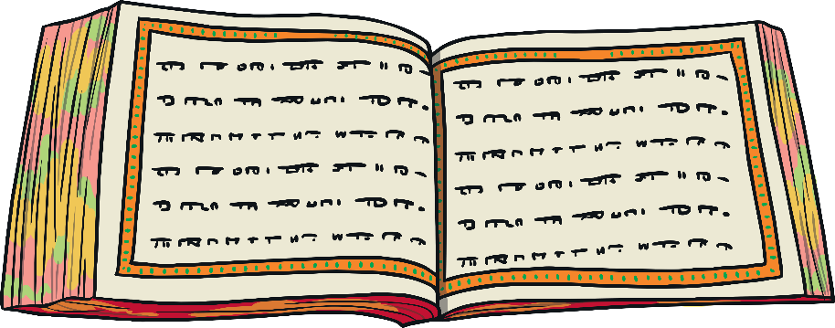

Starter Activity
What is the Qur’an?
What do you already know about it?

Slide 5
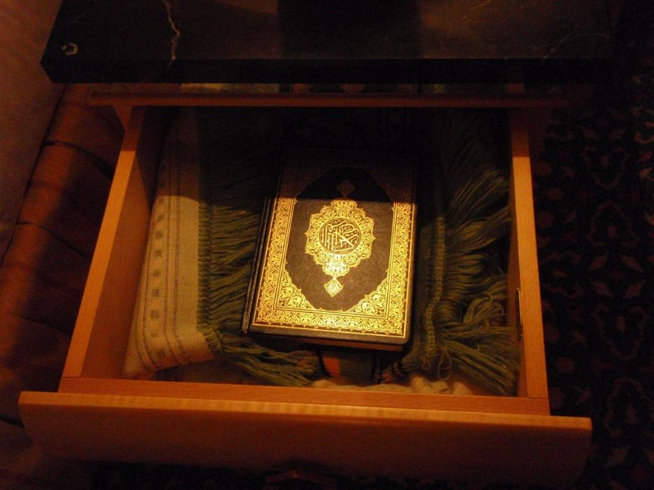
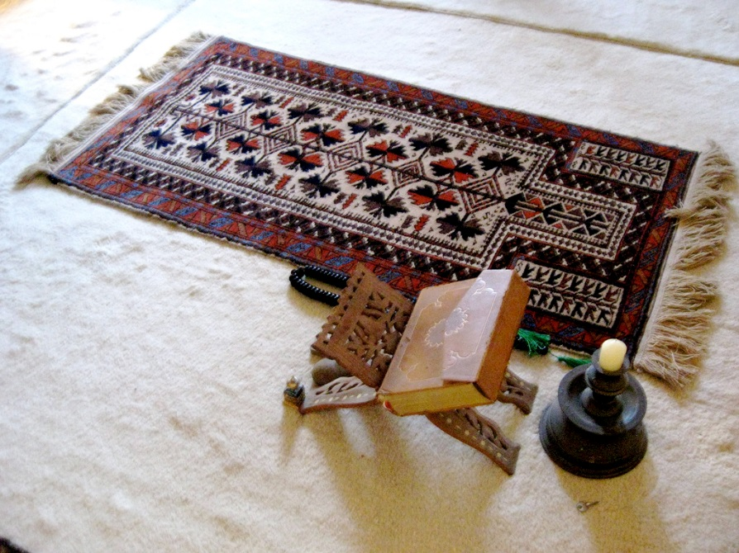
What is the Qur’an?
The Qur’an is the holy book for Muslims and is written in Arabic.
Muslims believe it is the perfect word of God.

Slide 6
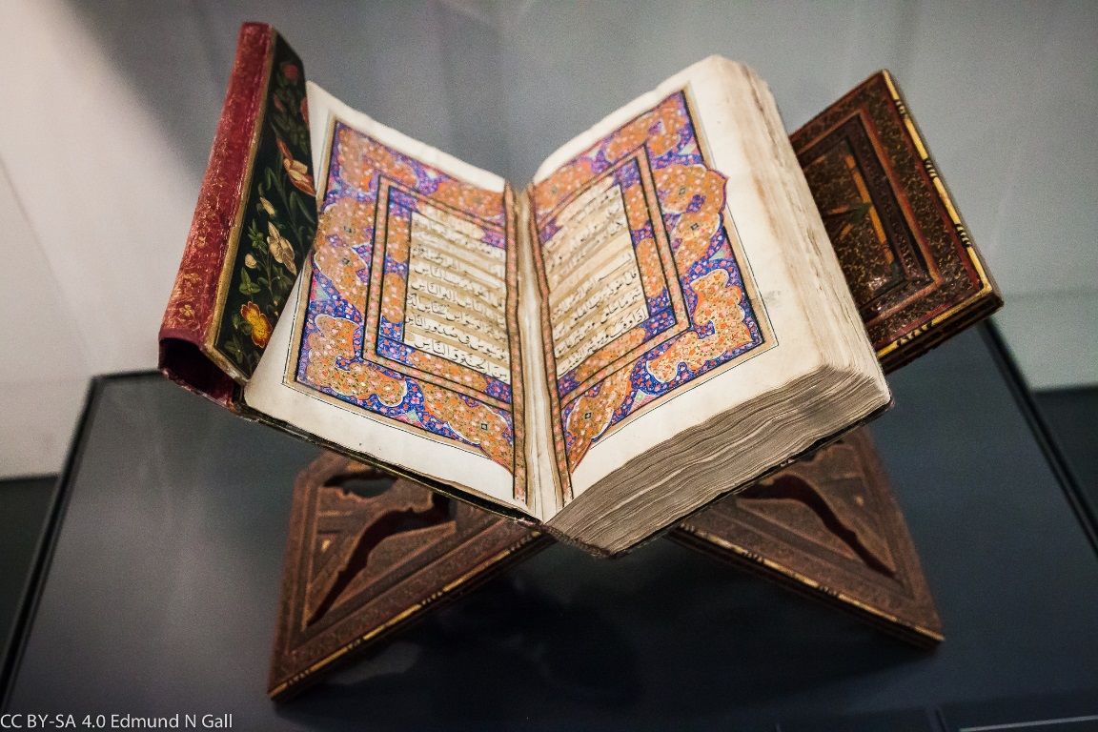
What is the Qur’an?
Muslims show respect for the Qur’an by washing their hands before touching it. When not being used, the Qur’an is often wrapped up in a special cloth and kept on a high shelf to show respect.
It must never touch the floor and is placed on a special stand when being read. Many Muslims around the world learn the Qur’an off by heart!

Slide 7
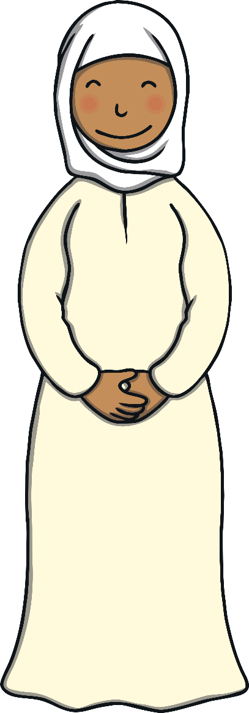
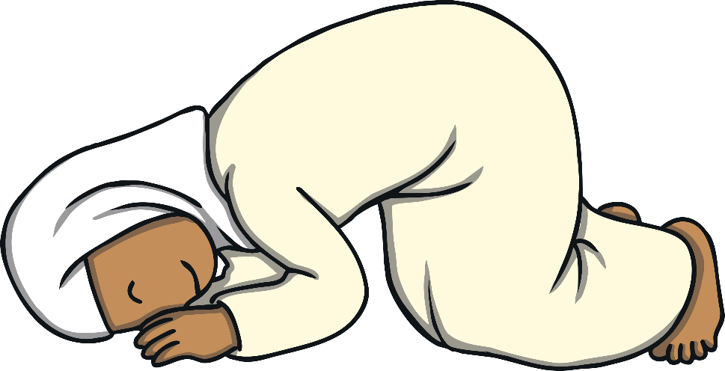
The Qur’an Activity
Watch the video to find out more about how children learn how to read the Qur’an.
BBC Bitesize

Slide 8
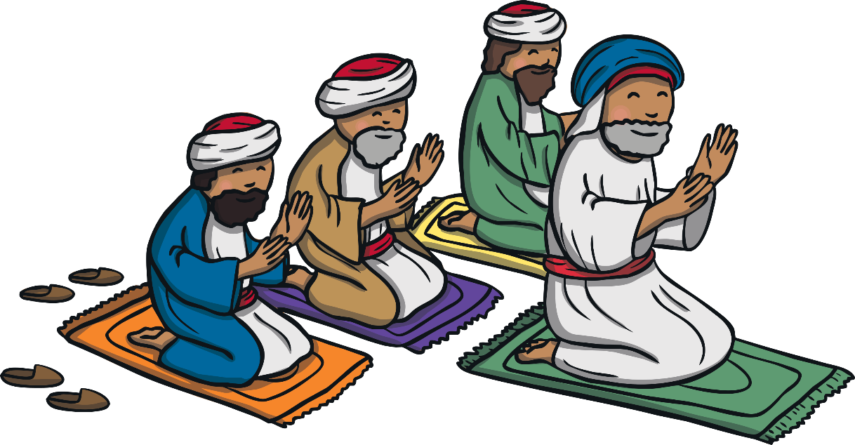
The Qur’an
The Qur’an teaches Muslims how to live a good life.
Here are just a few rules which Muslims must live by:
Worship only one God
Pray 5 times a day
Give to charity
Show respect and love to your parents
Show forgiveness to others

Slide 9

Plenary
Write down 3 things you have learned.
Write down a question you still have.
Why is the Qur’an special to Muslims?

