Slide 2



New Vocabulary
Learning new vocabulary helps us to communicate.
This includes being able to write more clearly, speak more specifically, and read with more understanding.

Slide 3

Strategies
Here are some strategies for learning new vocabulary:
  Compare and contrast
  Use
  Practice
  Visualize
  Definition
  Context clues

Slide 4

Context Clues
When learning new vocabulary, we can use context clues to find the meaning of a word.
For example, in this sentence, can you find out what the made up word ‘jhkrsl’ might mean using the context?
Megan was very tired after school. Though she knew she should complete her math jhkrsl that was due the next day, she took a rest first.

Slide 5


Definition
When possible, it is best to look up a definition of a new word that you come across in your reading, work, or in class.
Use a dictionary
to find the definition.
It is helpful to write the definition down in a notebook or a journal.

Slide 6

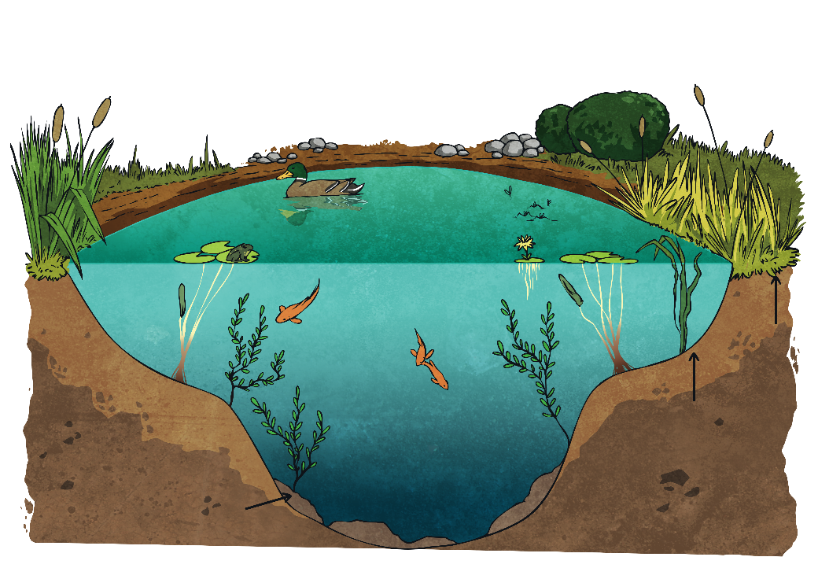
Visualize
Once you know what a new word means, visualize that word.
For example, if you learned the word “ecosystem” you would want to imagine a natural area with living and nonliving things.
If you learned the word “denominator,”
what would you visualize?

Slide 7

Practice
Practice is a great strategy when learning new words.
Practice spelling the word.
Practice using the word in a sentence.

Slide 8

Use
A helpful strategy to learn new words is to use them as much as possible.
Try to use the new word when you are speaking.
Try to use the new word when you are writing.
The more you use a word,
the faster you will learn and memorize its meaning.

Slide 9

Compare and Contrast
Comparing and contrasting things helps our brains to make important connections.
When you learn a new word, identify synonyms for that word.
When you learn a new word, identify antonyms for that word.

Slide 10

Review
What are six strategies for learning new vocabulary?
What is your favorite strategy and why?

