Slide 1

Lunsford Primary School
EYFS Parent Questionairre
March 2023

Slide 2
25 out of 30 parents/ carers completed the form – 83% of all parents in Panda Class – thank you so much for your feedback
“My child has been very happy and is very positive to go to school.”
“My child has settled really well into school life at Lunsford. The transitions they have had have been well planned and handled and despite a change of building and teacher within the first 3 terms he has remained settled and loved every day at school. The provision seems wide and varied and he has made good progress across all areas of learning. We are really happy with his start to formal education!”

Slide 3
Key highlights from questionnaire
1
100% of respondents stated that my child feels safe in Reception
2
100% of respondents stated that my child makes good progress in Reception
3
100% of respondents stated that my child is well looked after in Reception
4
100% of respondents stated that my child is taught well in Reception

Slide 4
Parental comments:
“(My son) is really enjoying his time in reception and has really warmed to Mrs Pring. We love to hear all about the adventures and learning that happens in class and Jack is thriving. Mrs Pring and Mrs Bruckin go above and beyond to offer exciting learning opportunities through play and deliver them with great energy and enthusiasm, thank you :) Tapestry is a great tool to keep parents up to date and Mrs Pring is fantastic at sharing lots with the families. Thank you for all your hard work and dedication :)”

Slide 5
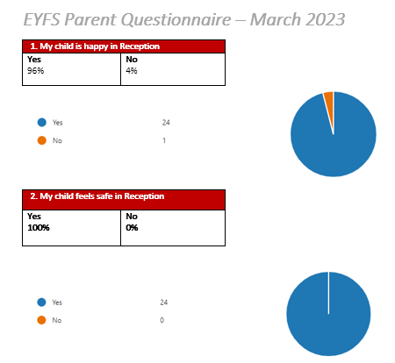
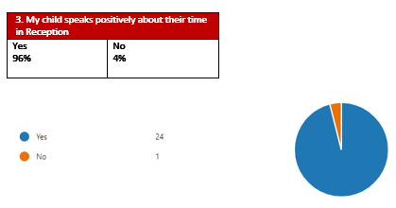
Results:
.

Slide 6
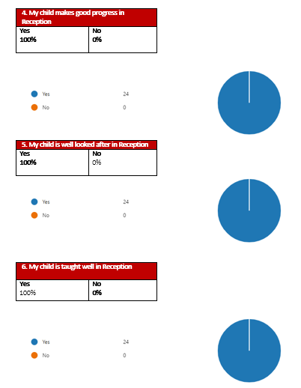
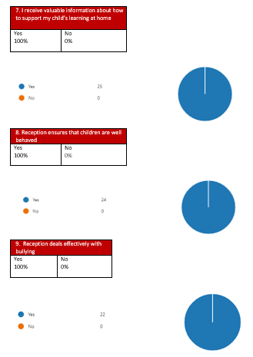
Results:

Slide 7
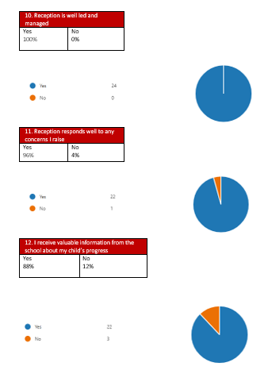
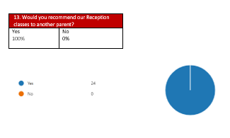
Results:

Slide 8
Quotes from parents/ carers:
“My child has been very happy and is very positive to go to school.”
“My child has settled really well into school life at Lunsford. The transitions they have had have been well planned and handled and despite a change of building and teacher within the first 3 terms he has remained settled and loved every day at school. The provision seems wide and varied and he has made good progress across all areas of learning. We are really happy with his start to formal education!”
“(My son) is really enjoying his time in reception and has really warmed to Mrs Pring. We love to hear all about the adventures and learning that happens in class and Jack is thriving. Mrs Pring and Mrs Bruckin go above and beyond to offer exciting learning opportunities through play and deliver them with great energy and enthusiasm, thank you :) Tapestry is a great tool to keep parents up to date and Mrs Pring is fantastic at sharing lots with the families. Thank you for all your hard work and dedication :)”
“Brilliant!”
“(My son) absolutely loves going to school every day. He is always so excited to come home and share all the fun activities he has done each day. We are so pleased with the progress he is making and that he has had such a brilliant start to his time at Lunsford.”
“(My daughter) very much enjoys her time in reception class, she's always got positive things to say and looks forward to going to school every morning.”
“I’m so happy with the progress (my daughter) has made since she has started at Lunsford. I have told my friends about the school and how happy I am about the school and I would definitely recommend the school to people.”
“My son loves school, I feel he has a wonderful class and teachers.”
“(My daughter) has loved her time in reception with her new teacher Mrs Pring. (She) is always excited to tell me what they’ve been up to and she lets me know when it’s a special day eg Chinese New Year etc. (She) enjoys being busy and loves learning new things and we feel that Mrs Pring has fulfilled this very well - your enthusiasm is infectious. Thank you.”
Notes:
In Slide Show mode, select the arrows to visit links.

