Slide 1
Little Wandle Letters and Sounds Revised
Lunsford has chosen Little Wandle Letters and Sounds Revised as our systematic, synthetic phonics (SSP) programme to teach early reading and spelling.
Why Little Wandle?
Excellent training for all staff to ensure consistency.
Every aspect of phonics and reading included in a detailed, thorough and systematic approach.
Engaging resources without distracting from the learning.
Comprehensive system for identifying and supporting children requiring extra help
Useful support for parents.

Slide 2
Phonics is:
making connections between the sounds of our spoken words and the letters that are used to write them down.
Notes:
It sounds complicated but it really isn’t!

Slide 3
How do we teach reading in books?
Reading practice sessions are:
timetabled three times a week
Decoding
Prosody
(intonation, expression)
Comprehension
taught by a trained teacher/ teaching assistant
taught in small groups.
Notes:
The children read the same book three times in a week. The first time we work on decoding (sounding out) the words, the second time we work on prosody which is reading with expression – making the book sound more interesting with our story-teller voice or our David Attenborough voice – and the third time we look at comprehension. We read the books three times at school because we want to develop the fluency. The more they see words the more they begin to read them automatically without having to sound them out.

Slide 4
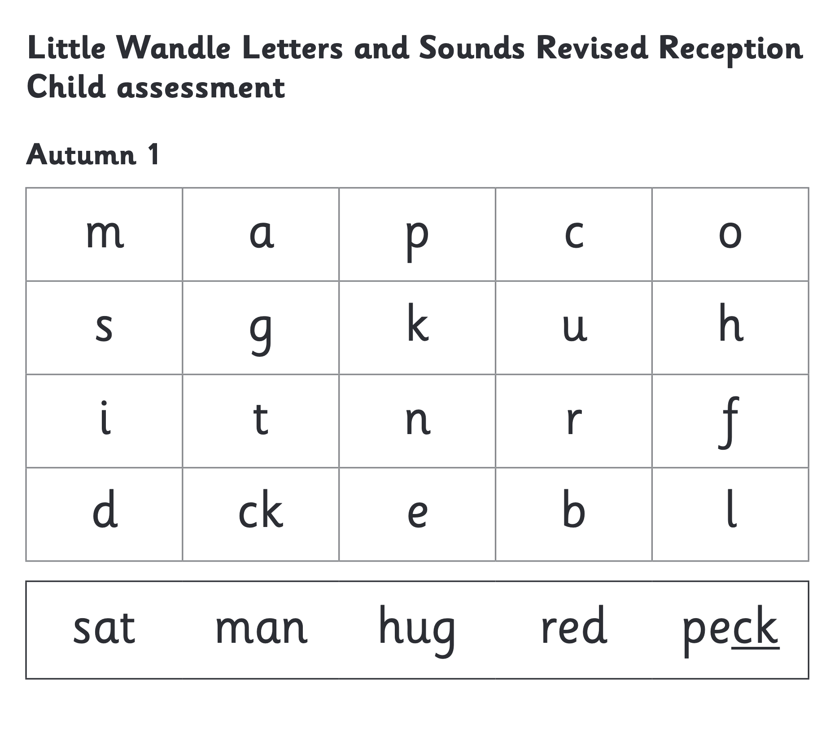
We use assessment to match your child the right level of book
Notes:
We assess your child every six weeks to check progress. Any child who needs extra support has daily keep-up sessions planned for them.

Slide 5
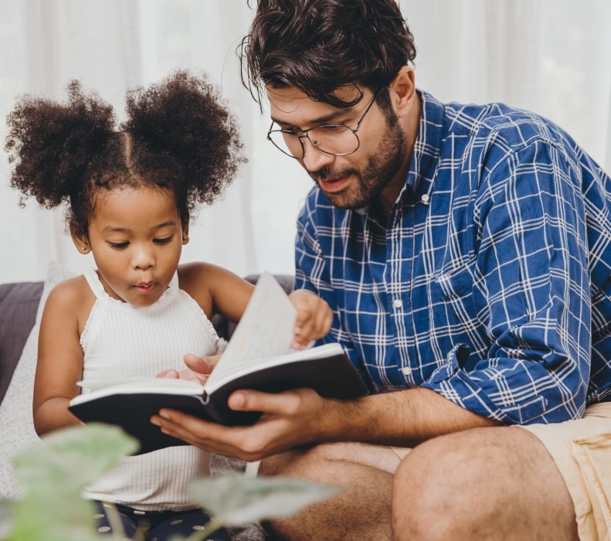
The most important thing you can do is read with your child
Reading a book and chatting about it had a positive impact a year later on children’s ability to…
understand words and sentences
use a wide range of vocabulary
develop listening comprehension skills.
The amount of books children were exposed to by age 6 was a positive predictor of their reading ability two years later.
Parental involvement in the development of children’s reading skills: A five-year longitudinal study (2002) Senechal, M. and Lefvre, J
Notes:
Celebrate child’s success at school, make time for reading at home!

Slide 6

Books going home weekly
1 x Phonics book
– to practise reading
1 x Reading for pleasure book
– to share
Notes:
As well as the ‘learning to read’ book that your child will bring home they will also bring home a book for sharing with you. This book is SO important. This is how we are going to give them the WILL to read. Please read with your child as often as you can – at least once a day if possible.

Slide 7
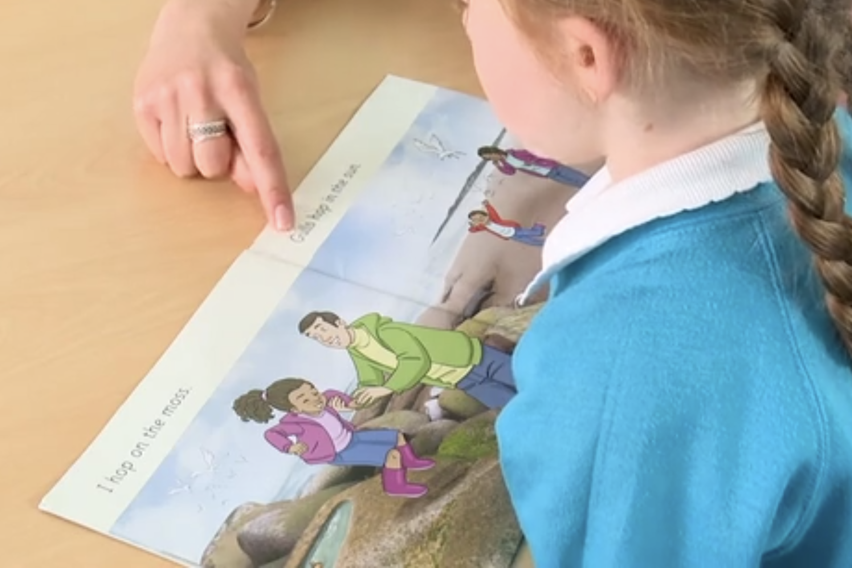
Reading a book at the right level
This means that your child should:
Know all the sounds and tricky words in their phonics book well
Read many of the words by silent blending (in their head) – their reading will be automatic
Only need to stop and sound out about 5% of the words by the time they bring the book home – but they should be able to do this on their own.
When children take their book home to read they should be 95% fluent.
Please do not worry that a book is too easy – your child needs to develop fluency and confidence in reading. Re-reading a book they have had before helps develop fluency – this is the goal.
Celebrate their success!!!

Slide 8
Supporting at home - Listening to your child read their phonics book
Your child should be able to read their book without your help.
If they can’t read a word read it to them.
Talk about the book and celebrate their success.
Please do not worry that a book is too easy – your child needs to develop fluency and confidence in reading.
Let your child “show off” their reading to you and celebrate and praise them!
Please look after our books and return to school on time! (lost books will be charged for)

Slide 9
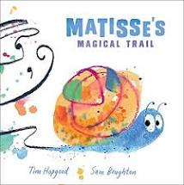

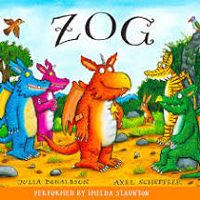

Supporting at home- Reading for pleasure books
Children will also bring home a ‘reading for pleasure book’ from our class library each week.
To become lifelong readers, it is essential that they read for pleasure
Children may not be able to read this book independently but you can read it to them. These books offer a wealth of opportunities for talking about the pictures and enjoying the story or information text.
Enjoy the book together and foster a love of reading
Make the story sound as exciting as you can by changing your voice.
Talk with your child as much as you can:
  Introduce new and exciting language Encourage your child to use new vocabulary
  Make up sentences together Find different words to use
  Describe things you see.

Slide 10

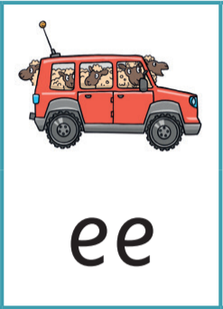

You may hear your children say….
-phonics (also known as ‘synthetic phonics’) – The teaching of reading by developing awareness of the sounds in words and the corresponding letters used to represent those sounds.
-phoneme - Any one of the 44 sounds which make up words in the English language.
-grapheme – How a phoneme is written down. There can be more than one way to spell a phoneme. E.g-the phoneme ‘ay’ is spelt differently in each of the words ‘way’, ‘make’, ‘fail’, ‘great’, ‘sleigh’ and ‘lady’.
-blending – Putting together the sounds in a word in order to read it, e.g.
‘f – r – o – g, frog’
-segmenting – Breaking a word into sounds in order to spell
them, e.g. ‘frog, f – r – o – g’’
-Digraph- 2 letters making one sound
-Trigraph- 3 letters making one sound

Slide 11
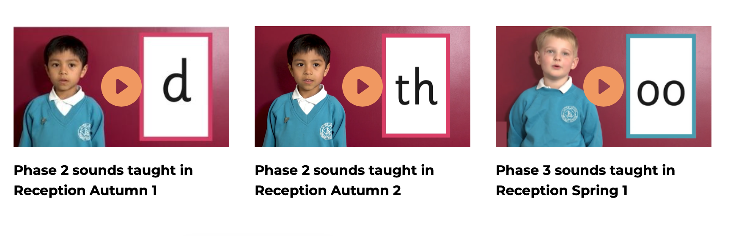
Supporting your child with phonics
https://www.littlewandlelettersandsounds.org.uk/resources/for-parents/
Notes:
It is really important that you pronounce the sounds correctly at home if you are supporting your child. These videos are on the website for you to refer to and if you are unsure, please ask your child’s teacher.
Show the parents where to access the videos on the website and play them!
https://www.littlewandlelettersandsounds.org.uk/resources/for-parents/

Slide 12
Reading books and sound sheets
Reading books will be sent home on a Friday afternoon.
The reading record is signed when your child reads with an adult in school.
Please can you sign their reading record when they read at home too.
It is really important that the reading books come back to school as we need them for the next group to read the following week.

Slide 13
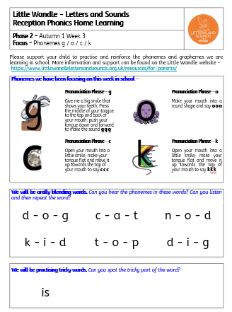
Sound sheet
Each week your child will receive a sheet which details the phonemes that the children have focused on during the week.
Look through the sheet and discuss the phonemes with the children and see if they are able to blend the words. If they struggle to do this try writing the sounds on paper and place together as a word. Can they verbally segment and blend?

Slide 14
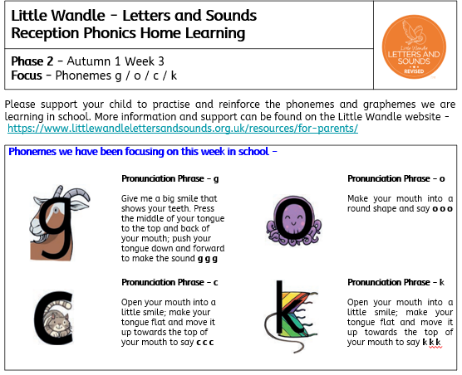
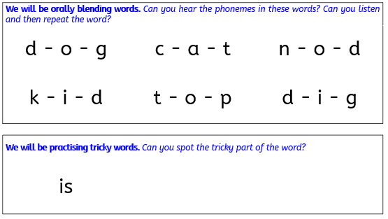

Slide 15
Things to do to support your child at home
Complete the home challenge sent out on a Friday
Read with your child daily – record in reading record
Try to say the sounds and spot them in the environment
Begin to mark make by trying to write the sound – in sand, rice, colourful pens, chalk etc
Make it fun, if they think it is a game they are more likely to respond. Share it with me on Tapestry then I can praise the children.

