Slide 1

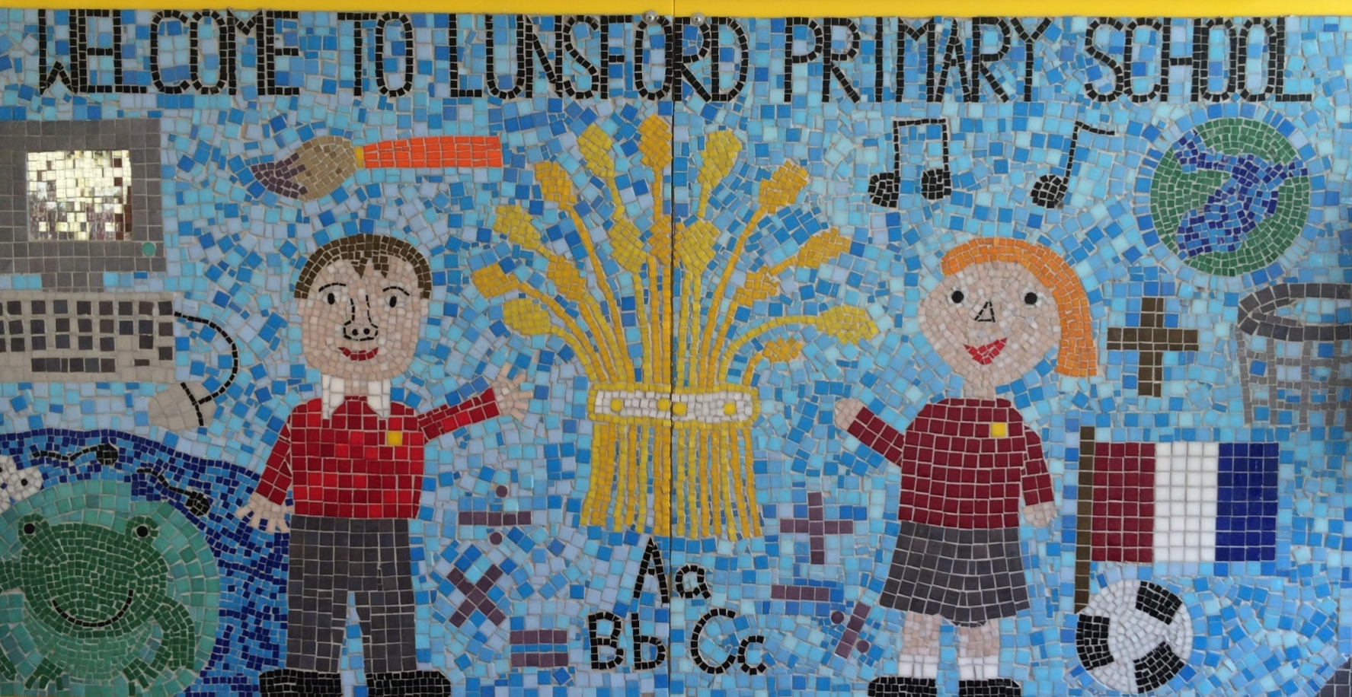
Lunsford Primary School
Welcome to our school!

Slide 2
Who’s Who?
Headteacher – Mr G Anscombe
Deputy Headteacher – Mrs E Lomax
Lion Class Teacher – Miss White and Mrs Regan (PPA- Friday mornings)
Lion Class Teaching Assistant –Mrs Coster
SENCO – Ms S Beckett ( Tues, Wed, Thurs)
FLO – Mrs A Taylor
Office Manager – Mrs K Mead
Co – Chairs of Governors – Mrs J Sharpe and Mr G Hodnett

Slide 3

Our Values:
Kindness Respect Positivity Perseverance Responsibility Hard work
OUR VALUES
We are KIND
We are RESPECTFUL
We are POSITIVE
We PERSEVERE
We are RESPONSIBLE
We are HARD WORKING

Slide 4
Our School Rules
Be SAFE
Be READY
Be RESPECTFUL

Slide 5
SCHOOL RULES – SAFE, READY, RESPECTFUL.
There are just 3 simple, clear and coherent behaviour expectations.
This makes it easy for adults and children to recognise good behaviours and expectations.
They are easy to follow and easy to remember enabling all children and all adults to embrace them.

Slide 6
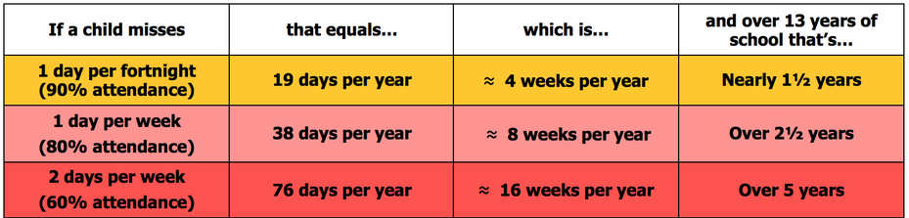
Attendance
Lunsford Primary monitors the attendance of every child in the school. We work with and support those children and their families who are not attending school without sufficient reason. Our attendance target for this academic year is 96.5% attendance.
To put this in perspective 95% sounds good, but means that your child misses:
one half day each fortnight
two weeks every school year
over three-quarters of a school year in a school career
Notes:
GA KM

Slide 7


Attendance
A key factor in a child’s success at school is regular and punctual attendance.
We will reward good attendance
We will be robust in chasing up poor attendance and children who are persistently late
Term-time holidays will not be authorised unless there
are exceptional circumstances
Notes:
GA KM

Slide 8
Uniform
The expectation is that all children will wear the correct school uniform. This includes smart, black shoes.
No such thing as inappropriate weather – only inappropriate clothing!
Sweatshirt, Polo Shirt, Black/grey trousers/skirt, summer dresses – red and white
PE Kit in to be worn on PE days
Labelled please
Order from Brigade online.
We want to foster and develop a real pride in our school from the very beginning
Notes:
GA EL

Slide 9


Slide 10
Welcome to Lion Class!
We really want to work together with you as parents, to ensure all the children have the best year possible.
As the year progresses we are keen for the children to develop their independence now they are in KS2.
With this in mind, we have high expectations for both work and behaviour including:
Presentation of work
Positive attitude to learning
Concentration/ being ready to learn each lesson
Working to their full potential
Taking responsibility for their learning

Slide 11
Our Topics
Autumn Term
History- The Romans
Geography- Brazil
Science- Animals Including Humans/Light
Spring Term
History- The Stone Age/The Iron Age to The Bronze Age
Science- Forces and Magnets/Rocks
Summer Term
Geography- Volcanoes/Rivers
Science- Plants

Slide 12
Spellings
In Year 3, we will be teaching spelling three times a week focusing on the Y3/4 word lists and spelling patterns from the National Curriculum.
We will also be recapping spelling strategies learnt in Year 2 eg. Homophones, suffixes etc.

Slide 13
Times Tables
Times tables is a key area of Maths in Year 3 and beyond! Good knowledge of times tables is essential.
We will have weekly times tables lessons.
This year we will be revising our 2x, 5x and 10x tables (Autumn Term) and learning our 3x, 4x and 8x tables (Spring- Summer Term).
Helping your child learn their times tables is the best way you can support their Maths at home.
We use TT Rockstars in school which children can also access at home. www.ttrockstars.com
All children have their own log in and they can earn points for the number of questions they answer correctly.

Slide 14
Times Tables
Some other popular websites are www.multiplication.com or www.timestables.co.uk
There are various strategies you can use to help your child learn their tables but you need to find what works best for them!
As well as the times table fact, children need to learn the corresponding division fact
Eg. 3 x 5 = 15
5 x 3 = 15
15 ÷ 3 = 5
15 ÷ 5 = 3

Slide 15
Reading
This year reading is very important.
Please listen to your child (even if they are fluent) every night and ensure that it is recorded in their record book. We will be using these everyday so they must be in school daily.
On a Wednesday evening, please sign your Buster Book Club bookmark with a record of how many minutes your child has read for. We have a weekly competition to see which class reads the most!
Try to encourage your child to read a variety of texts to help widen their knowledge and experiences of reading.
It is very important that children understand what they are reading.
mention Buster Book Club!

Slide 16
Homework
Homework will be sent home on a Thursday to be returned to school the following Wednesday.
SPAG/Reading and Maths.
All children have a homework book and their work must be completed in pencil.
We do not expect children to spend longer than 30 minutes on a task.
If there are any problems, please encourage your child to speak to an adult in class who can help them with it.

Slide 17
Ongoing Homework
Reading to an adult 5 times a week
Practicing times tables
Spelling patterns and Year3/4 words

Slide 18
PE
Term 1- Mondays
Trainers (which might get muddy), PE t-shirt, shorts, jogging trousers, sun hat for summer, spare socks (for those wearing tights).
Forest School dates will be posted on Class Dojo!
Children to wear PE kit on PE days
Earrings must be taken out and long hair tied back.
Please make sure all items of PE kits and uniform are named.

Slide 19
Swimming
Swimming will be Friday afternoons (2-2.30) Terms 1-4.
Swimming kit- towel and swimming costume/shorts in a separate, named bag. If your child needs goggles, please bring those too.
Earrings must be taken out and long hair must be tied back- plaits.
We will be walking to Larkfield Leisure Centre.

Slide 20
Assessment
Ongoing informal assessments during the year for reading, writing and maths
We assess the children regularly and also conduct Pupil Progress Meetings three times a year to ensure your child is on track to meet their targets.
If you have any concerns about your child and their progress, please make an appointment to see Miss White.

Slide 21
Online Safety
Many Lunsford children regularly use the internet and social media and we have a duty to help them keep safe online.
Users should be sixteen to use WhatsApp and thirteen to use Instagram, Snapchat, Twitter, Facebook, Skype and TikTok.
Although there is no age restriction for watching YouTube videos, users need to be thirteen to have their own YouTube account enabling them to subscribe to channels, like videos, post comments and add videos.

Slide 22
Online Safety
If your child does use social media, please help them to check their privacy settings, disable any chat settings and ensure they know how to block and report.
www.net-aware.org.uk provides lots of up-to-date information for parents.
Please let us know if there any issues regarding the online behaviour of Lunsford children at any time.
We will always follow this up within school in line with our online safety, safeguarding, behaviour and acceptable use policies.
Please see Mrs Lomax if you have any other queries about online safety.

Slide 23
Getting in Contact
At Lunsford, we have an open door policy. We want to work in partnership with parents and carers and strive to achieve the best for all children.
We ask that if you have any worries or questions regarding your child or a problem related to school, please do not hesitate to contact us so we can understand your concerns and help to solve any issues . If we do not know there is a problem, it is very difficult for us to help you or your child.
If you feel that an issue has not been dealt with appropriately, please speak to Mr Anscombe or Mrs Lomax, or we will happily provide you with a copy of the formal complaints procedures.

Slide 24
Getting in Contact
If you would like to speak to a member of staff…
Mrs Mead will forward on any emails and pass on any telephone messages.
Miss White can be contacted via Class Dojo. I will try to reply as soon as possible but urgent messages should be sent via the office as I will not necessarily be able to access Dojo whilst teaching!
A member of the Senior Leadership Team will also be available on the playground every morning and afternoon.
Our Family Liaison Officer (FLO) Amy Taylor can be contacted on 07552 045390.

