Slide 1

Grosvenor Hall
14th – 15th May 2020

Slide 3


Slide 4
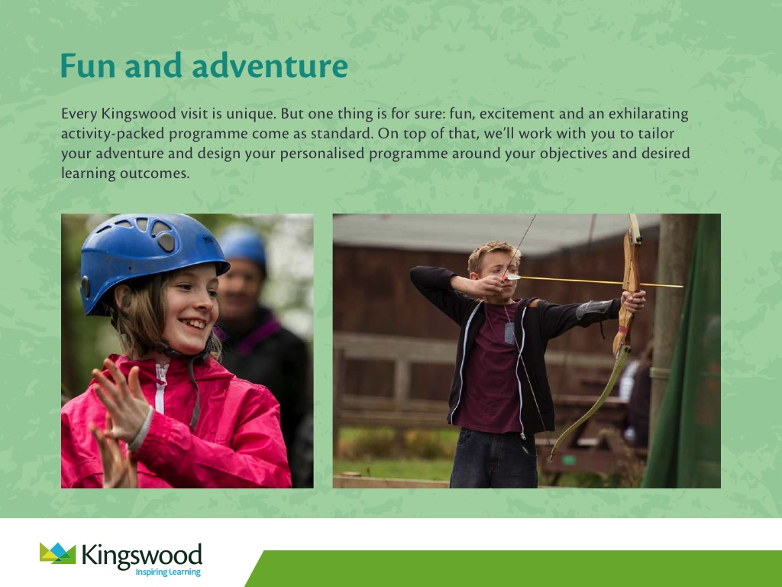

Slide 5
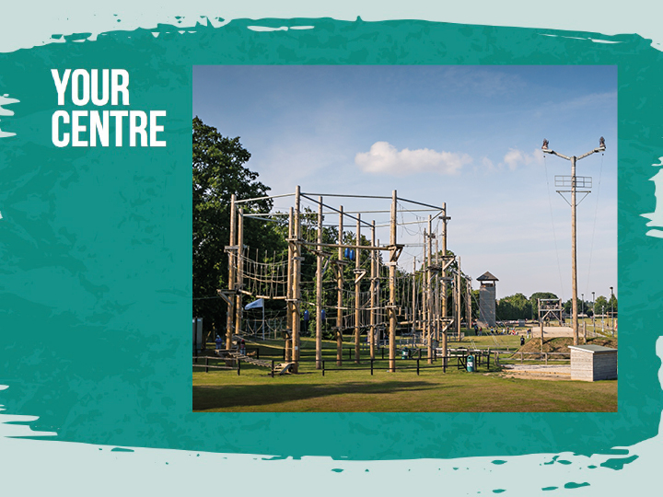

Slide 6
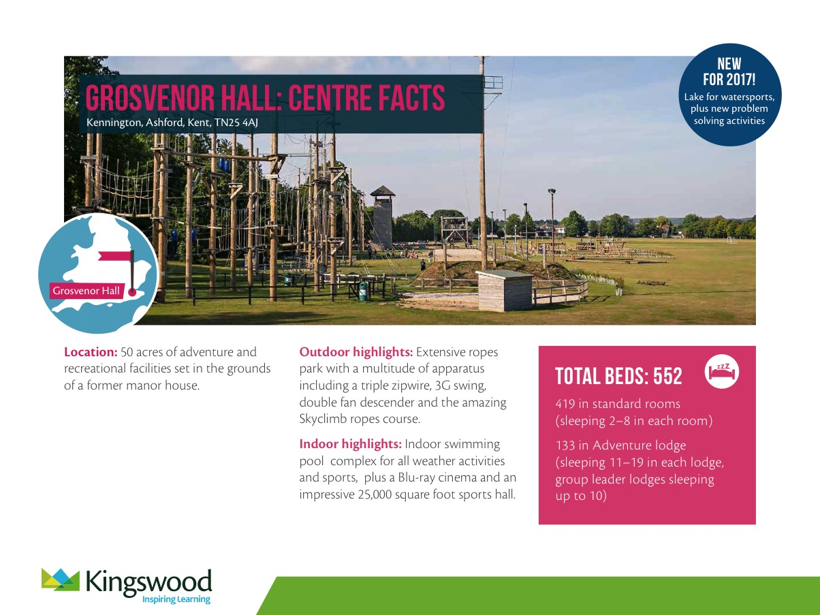
Location: 50 acres of adventure and recreational facilities set in the grounds of a former manor house.
Outdoor highlights: Extensive ropes park with a multitude of apparatus including a triple zipwire, 3G swing, double fan descender and the amazing Skyclimb ropes course.
Indoor highlights: Indoor swimming pool complex for all weather activities and sports, plus a Blu-ray cinema and an impressive 25,000 square foot sports hall.
TOTAL BEDS: 552
419 in standard rooms
(sleeping 2-8 in each room)
133 in Adventure lodges
(sleeping 11–27 in each lodge, group leader lodges sleeping up to 10)

Slide 7
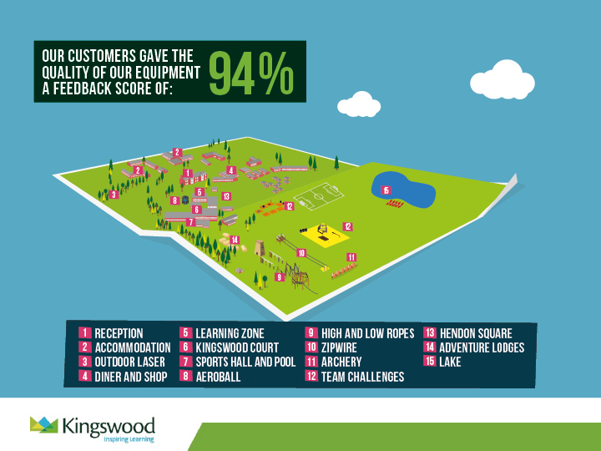

Slide 8

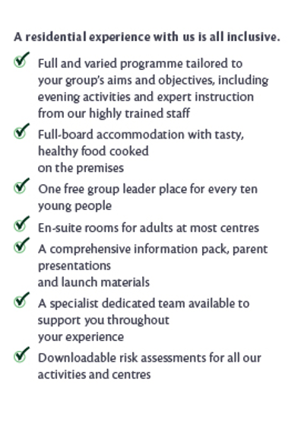
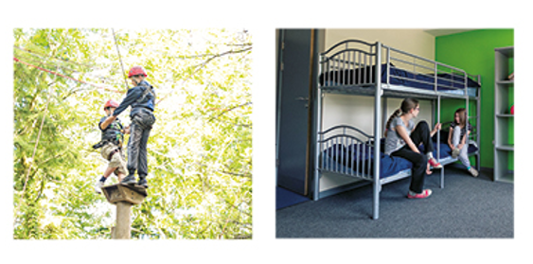
You’ll find welcoming rooms in our comfortable dormitory style accommodation. You will sleep in a choice of standard accommodation, or Adventure Lodges, all of which have bathroom facilities and a daily housekeeping check. All of our accommodation is secure and comfortable and all bedding is provided. Pupils sleep in gender separated areas, with separate showers and toilet facilities, and teacher rooms are located close by to allow for plenty of supervision.

Slide 9


Slide 10
We know how daunting it can be letting your child go on a residential visit, so we do everything we can to make it a safe and enjoyable experience for all.
Our policies and procedures are designed to make sure we adhere to the highest safety standards at all times:
Continual safety and first aid training for all staff
Regular checks on equipment before and after every activity session
Qualified First-Aider on centre 24/7
All staff are fully DBS checked.
We create a warm, supportive environment for students so they quickly feel at home. All our activities are progressive, allowing students to join in at whatever level they’re comfortable with.
We have found the best way to help children cope with being away from home is to keep them busy, having fun from dawn ‘til dusk.
Kingswood cannot guarantee 100% safety for personal items brought onto centre and they will not be covered by insurance. It is therefore advisable to leave valuables – cameras, mobiles, iPods, MP3 players, computer games, jewellery - at home. A clearly named disposable camera is acceptable.

Slide 11
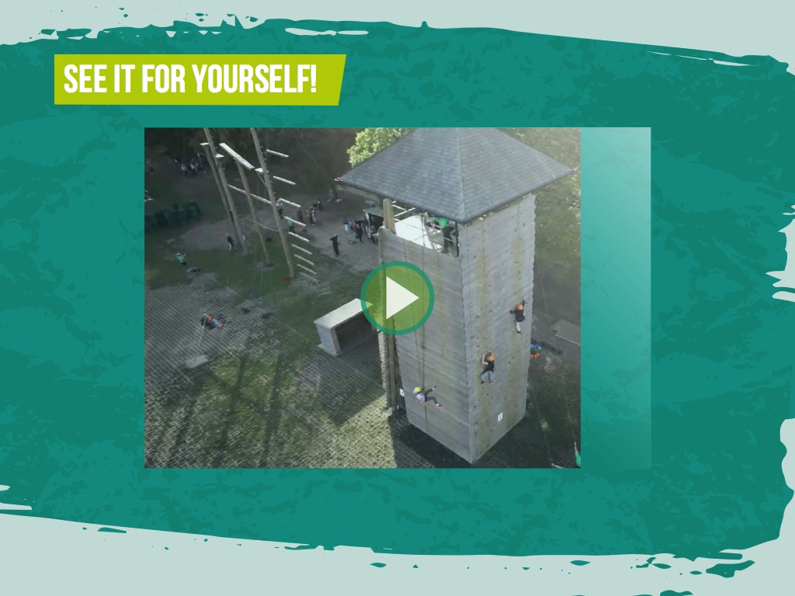
https://www.youtube.com/channel/UCy0___ghMVMWC_5THw2iogg

Slide 12


Slide 14


