Slide 1

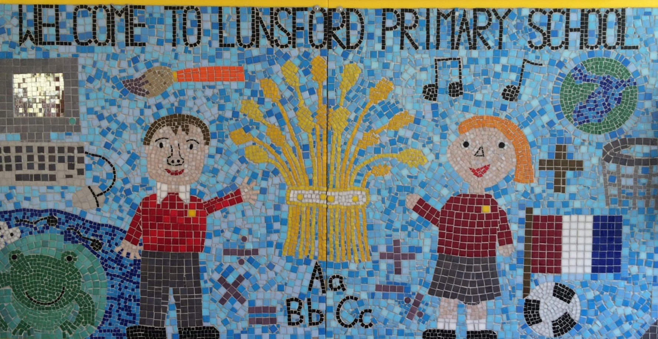
Lunsford Primary School
Welcome to our school!

Slide 2
Who’s Who?
Headteacher – Mr G Anscombe
Deputy Headteacher – Mrs E Lomax
Koala Class Teacher – Miss Broadmore PPA Cover- Mrs Regan (Friday- this will alternate each term)
Koala Class Teaching Assistant – Mr Murray and Mrs Barton (Monday- Thursday))
SENCO – Ms S Beckett ( Tues, Wed, Thurs)
FLO – Mrs A Taylor
Office Manager – Mrs K Mead
Co – Chairs of Governors – Mrs J Sharpe and Mr G Hodnett

Slide 3

Our Values:
Kindness Respect Positivity Perseverance Responsibility Hard work
OUR VALUES
We are KIND
We are RESPECTFUL
We are POSITIVE
We PERSEVERE
We are RESPONSIBLE
We are HARD WORKING

Slide 4
Our School Rules
Be SAFE
Be READY
Be RESPECTFUL

Slide 5
SCHOOL RULES – SAFE, READY, RESPECTFUL.
There are just 3 simple, clear and coherent behaviour expectations.
This makes it easy for adults and children to recognise good behaviours and expectations.
They are easy to follow and easy to remember enabling all children and all adults to embrace them.

Slide 6
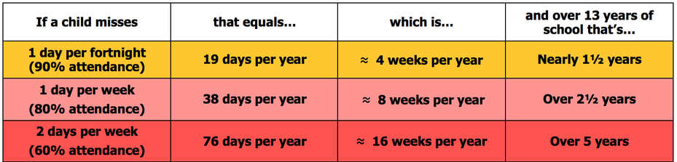
Attendance
Lunsford Primary monitors the attendance of every child in the school. We work with and support those children and their families who are not attending school without sufficient reason. Our attendance target for this academic year is 96.5% attendance.
To put this in perspective 95% sounds good, but means that your child misses:
one half day each fortnight
two weeks every school year
over three-quarters of a school year in a school career
Notes:
GA KM

Slide 7


Attendance
A key factor in a child’s success at school is regular and punctual attendance.
We will reward good attendance
We will be robust in chasing up poor attendance and children who are persistently late
Term-time holidays will not be authorised unless there
are exceptional circumstances
Notes:
GA KM

Slide 8
Uniform
The expectation is that all children will wear the correct school uniform. This includes smart, black shoes.
No such thing as inappropriate weather – only inappropriate clothing!
Sweatshirt, Polo Shirt, Black/grey trousers/skirt, summer dresses – red and white
PE Kit in to be worn on PE days
Labelled please
Order from Brigade online.
We want to foster and develop a real pride in our school from the very beginning
Notes:
GA EL

Slide 9


Slide 10
Welcome to Koala Class!
Year 4 is a very exciting year with lots of new opportunities for the children including learning to play the violin and an overnight residential trip to Kingswood!
We really want to work together with you as parents, to ensure all the children have the best year possible.

Slide 11
Koala Class expectations
As the year progresses, we are keen for the children to develop their independence, particularly in preparation for their transition to upper KS2.​
With this in mind, we have high expectations for both work and behaviour including:​
Presentation of work​
Positive attitude to learning​
Concentration / being ready to learn each lesson​
Working to full potential​
Taking responsibility

Slide 12
Our Topics
Autumn Term
History- Anglo Saxons (Trip to Kent Life in Term 2)
Geography- Plastic Pollution
Science- States of Matter and Animals including Humans
Spring Term
History- World War II
Geography- Regions of the UK
Science- Sound and Electricity
Summer Term
History- Ancient Egyptians
Geography- Mountains
Science- Living Things

Slide 13
Spellings
In Year 4, spellings will be taught three times a week focusing on the Y3/4 word lists and spelling patterns from the National Curriculum.
We will continue to follow Spelling Shed.
It would really benefit your child if you are able to spend time on Spelling Shed to consolidate their learning.
A list of Y3/4 spellings are on our class page on the website.

Slide 14
Times Tables
Times tables are extremely important this year.
Quick recall of times tables and the related division facts are vital for success in Maths in Year 4 and beyond.
June 2025- a timed multiplication tables check for all Y4 pupils
This will be completed online in school

Slide 15
Times Tables
Times tables will be taught twice a week in school
Tested once a term- soundcheck on TT Rockstars
Children will have a times tables test fortnightly on a Friday morning
We will continue to use Times Table Rockstars
All children have an individual login. These are stuck in their reading records
Please encourage your child to access TT Rockstars at home as much as possible. Little and often is best!

Slide 16
Reading
Regular reading continues to be of key importance in Year 4, even if your child is a confident reader.
Comprehension skills are taught 3 times a week in school focusing on reading strategies, vocabulary and comprehension.
BUSTER BOOK CLUB- Please ensure any reading is recorded in children’s reading records.

Slide 17
Homework
Homework will either be an arithmetic task or a reading comprehension.
This will alternate each week.
Please ensure presentation is neat in homework books.
Homework will be sent home on a Thursday to be returned the following Wednesday.
Please encourage your child to ask an adult if they are struggling with any homework.

Slide 18
PE
Mondays with Mr Dickinson
Wednesdays with Miss Broadmore
Outdoor Games Trainers (which might get muddy), PE t-shirt, shorts, jogging trousers, sun hat for summer, spare socks (for those wearing tights).
Children to wear PE kit on PE days
Earrings must be taken out and long hair tied back.
Please make sure all items of PE kits and uniform are named.

Slide 19
KINGSWOOD
Kingswood will be 17th- 18th March 2025
Sign up date on Arbor is 10th February 2025
I will do a meeting with parents closer to the date with all relevant information

Slide 20
Violins
This year, children will be learning to play the violin every Thursday morning.
Violins are provided and children will be able to bring them home at the start of Term 2

Slide 21
Assessment
Ongoing informal assessments during the year for reading, writing and maths
We assess the children regularly and also conduct Pupil Progress Meetings three times a year to ensure your child is on track to meet their targets.
If you have any concerns about your child and their progress, please make an appointment to see Miss Broadmore

Slide 22
Online Safety
Many Lunsford children regularly use the internet and social media and we have a duty to help them keep safe online.
Users should be sixteen to use WhatsApp and thirteen to use Instagram, Snapchat, Twitter, Facebook, Skype and TikTok.
Although there is no age restriction for watching YouTube videos, users need to be thirteen to have their own YouTube account enabling them to subscribe to channels, like videos, post comments and add videos.

Slide 23
Online Safety
If your child does use social media, please help them to check their privacy settings, disable any chat settings and ensure they know how to block and report.
www.net-aware.org.uk provides lots of up-to-date information for parents.
Please let us know if there any issues regarding the online behaviour of Lunsford children at any time.
We will always follow this up within school in line with our online safety, safeguarding, behaviour and acceptable use policies.
Please see Mrs Lomax if you have any other queries about online safety.

Slide 24
Getting in Contact
At Lunsford, we have an open door policy. We want to work in partnership with parents and carers and strive to achieve the best for all children.
We ask that if you have any worries or questions regarding your child or a problem related to school, please do not hesitate to contact us so we can understand your concerns and help to solve any issues . If we do not know there is a problem, it is very difficult for us to help you or your child.
If you feel that an issue has not been dealt with appropriately, please speak to Mr Anscombe or Mrs Lomax, or we will happily provide you with a copy of the formal complaints procedures.

Slide 25
Getting in Contact
If you would like to speak to a member of staff…
Mrs Mead will forward on any emails and pass on any telephone messages.
Miss Broadmore can be contacted via Class Dojo. I will try to reply as soon as possible (within 24 hours during the week) but urgent messages should be sent via the office as we will not necessarily be able to access Dojo whilst we are teaching!
A member of the Senior Leadership Team will also be available on the playground every morning and afternoon.
Our Family Liaison Officer (FLO) Amy Taylor can be contacted on 07552 045390.

Slide 26
Lunsford Primary School
Welcome to our school!

