Slide 1

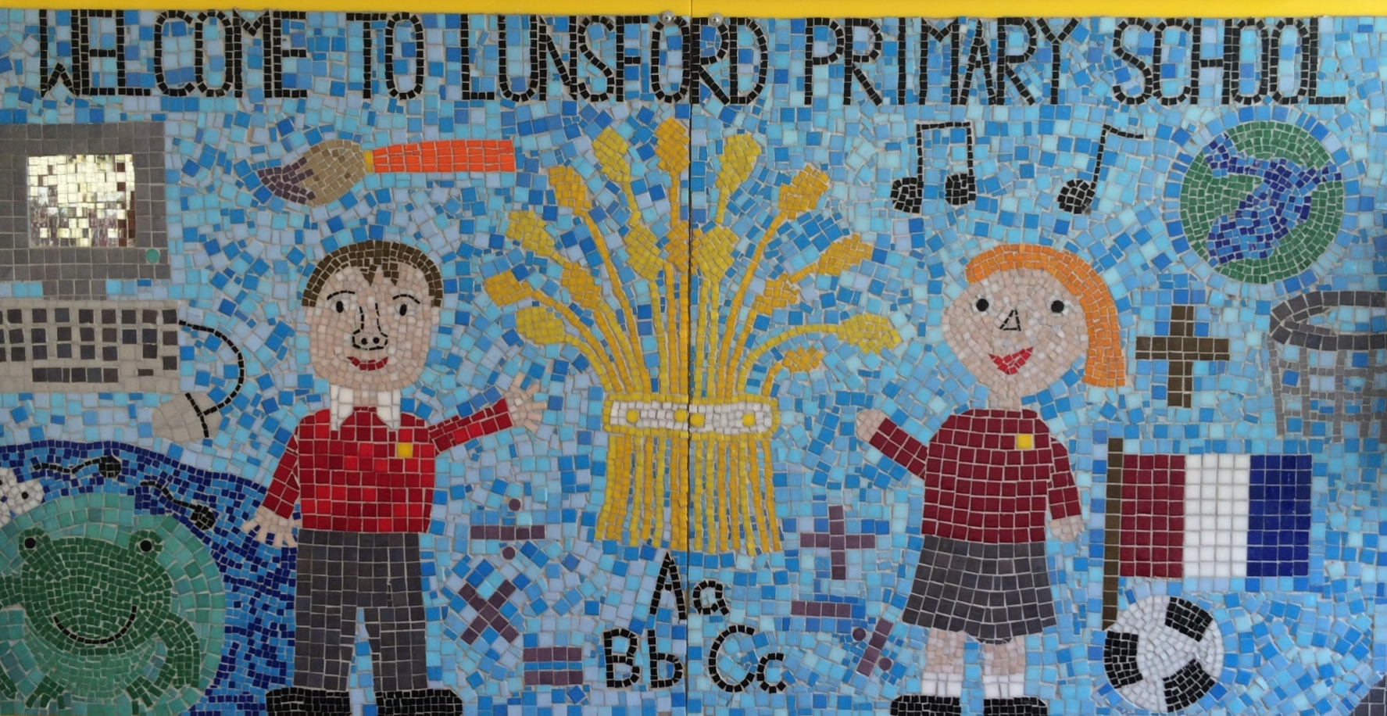
Lunsford Primary School
Welcome to our school!

Slide 2
Who’s Who?
Headteacher – Mr G Anscombe
Deputy Headteacher – Mrs E Lomax
Zebra Class Teachers – Mrs Walker (Mondays, Tuesdays, Wednesdays, Thursday mornings and Mrs Lomax (Thursday afternoons and Fridays)
Zebra Class Teaching Assistants – Mrs James and Mrs Anderson (mornings, apart from a Friday)
SENCO – Mrs S Beckett (Tues, Wed, Thurs)
FLO – Mrs A Taylor
Office Manager – Mrs K Mead

Slide 3

Our Values:
Kindness Respect Positivity Perseverance Responsibility Hard work
OUR VALUES
We are KIND
We are RESPECTFUL
We are POSITIVE
We PERSEVERE
We are RESPONSIBLE
We are HARD WORKING

Slide 4
Our School Rules
Be SAFE
Be READY
Be RESPECTFUL

Slide 5
SCHOOL RULES – SAFE, READY, RESPECTFUL
There are just 3 simple, clear and coherent behaviour expectations.
This makes it easy for adults and children to recognise good behaviours and expectations.
They are easy to follow and easy to remember, enabling all children and all adults to embrace them.

Slide 6
BE SAFE
We are SAFE when:
we move around school in a safe manner;
we follow instructions to keep ourselves safe e.g. on school trips;
we use equipment safely;
we stay safe online;
we cross roads safely;
we keep our hands and feet to ourselves.

Slide 7
BE READY
We are READY to learn when:
we arrive at school on time;
we have our equipment ready;
we show that we are listening,
we are ready to start lessons;
ready to listen and follow instructions.

Slide 8
BE RESPECTFUL
We are RESPECTFUL when:
we listen when others speak;
we respect the property of our friends and the school;
we show manners;
we consider others' feelings;
we focus our attention;
we show effort.

Slide 9
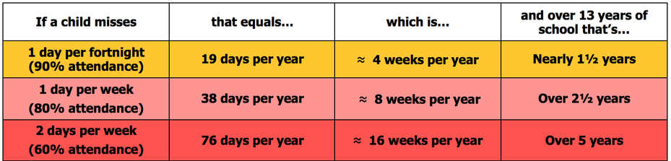
Attendance
Lunsford Primary monitors the attendance of every child in the school. We work with and support those children and their families who are not attending school without sufficient reason. Our attendance target for this academic year is 96.5% attendance.
To put this in perspective 95% sounds good, but means that your child misses:
one half day each fortnight
two weeks every school year
over three-quarters of a school year in a school career
Notes:
GA KM

Slide 10


Attendance
A key factor in a child’s success at school is regular and punctual attendance.
We will reward good attendance
We will be robust in chasing up poor attendance and children who are persistently late
Term-time holidays will not be authorised unless there
are exceptional circumstances
Notes:
GA KM

Slide 11
Uniform
The expectation is that all children will wear the correct school uniform. This includes smart, black shoes.
No such thing as inappropriate weather – only inappropriate clothing!
Sweatshirt, Polo Shirt, Black/grey trousers/skirt, summer dresses – red and white
PE Kit to be worn on PE days
Labelled please
Order from Brigade online.
We want to foster and develop a real pride in our school from the very beginning
Notes:
GA EL

Slide 12


Slide 13
Year 6 Expectations
We have high expectations for work and behaviour in preparation for secondary school.
Eg. Presentation of work
Positive attitude to learning
Concentration / being ready to learn each lesson
Working to full potential
Taking responsibility – for themselves, their learning, their belongings
Throughout the year, children will have the opportunity to take on extra responsibilities around the school so they are expected to set a good example to others.

Slide 14
Autumn Term Topics
Autumn Term
Science: Animals including humans (the circulatory and digestive system) and Electricity
Computing: Systems & networks and Creating Media – 3D modelling
History: The Maya
Geography: Biomes
Art: Drawing (Expressing ideas)
D&T: Electrical Systems (Design and make a steady hand game)
French: The Weather
PE: Tag Rugby and Cricket

Slide 15
Spring Term Topics
Spring Term
Science: Evolution & Inheritance and Light
Computing: Creating Media – web page creation & Spreadsheets
History: Crime and Punishment
Geography: Fair Trade
D&T: Structures (playgrounds) and Textiles (waistcoats)
French: Clothes
PE: PASS, Orienteering, netball

Slide 16
Summer Term Topics
Summer Term
Science: All living things and their habitats
Computing: Variables and Sensing
History: Local study
Geography: Coasts – linked to the Isle of Wight trip
Art: Painting and Mixed Media (Art work: David Hockney) and Sculpture and 3D form (making a memory box)
French: The Weekend
PE: Swimming

Slide 17
Things to Look Forward to in Y6…
Magistrates visit (November 2025)
Bikeability ( December 2025)
Swimming lessons (after Easter 2026)
Year 6 production (June / July 2026)
Isle of Wight residential trip (July 2026)
Leavers’ Assembly (July 2026)
Traditionally a group of Y6 parents organise an end of year party / prom for the class and also organise leavers’ jumpers and / or yearbooks. Please speak to Mrs Lomax if you would like to lead / help with this ☺

Slide 18
Spellings and Times Tables
Children in Year 6 are expected to have instant recall of all times table and division facts up to 12 x 12 and be able to apply this to solve other problems and areas of mathematics.
All children should continue to use TT Rock Stars regularly to practise and improve their speed of recall.
We complete an arithmetic test weekly and children are encouraged to improve their own score.
Spellings patterns will be taught using Spelling Shed which the children have a log in to access at home. On a Wednesday, children will complete a ‘Hive’ in class, which is an online test focusing on that week’s spellings.

Slide 19
Reading
Regular reading is so important and has a real impact on children’s progress and work. It is very evident in children’s work who is a regular reader and who is not!
Reading to your child is really valuable for all children, even Year 6!
A minimum of 10-15 minutes daily reading is expected. In Year 6 we would like children to read to an adult at least once a week and discuss the book they are reading – what will happen next, are there any words they are unsure of.
Reading record books should be completed when children read to themselves or an adult. Children need to write a comment about the book if they are completing the reading record themselves.
We will be continuing to take part in Buster Book Club so please ensure that bookmarks and reading records are signed on Wednesday evenings ready for the data to be collected on Thursdays.

Slide 20
Homework
Good homework habits are very important in Year 6 as we prepare for secondary school.
This term, homework will be given out on a Wednesday to be returned to school the following Tuesday.
Reading comprehension
Arithmetic
All homework is gone through with the children in class before it is sent home. If your child has any difficulties with homework, please encourage them to speak to Mrs Walker or Mrs Lomax before it is due in.

Slide 21
Homework
Children should work in a quiet area to complete their homework.
All children have a homework book which will come home each week to complete homework in.
Expectations for homework will increase as the year goes on in preparation for SATs and for secondary school.

Slide 22
PE
Chris Dickinson – PE teacher.
Monday – PE lesson with Mr Dickinson
Tuesday – Cricket
Outdoor Games Trainers (which might get muddy), PE t-shirt, shorts, jumper, jogging trousers, sun hat for summer.
Indoor PE House t-shirt, shorts, trainers.
Forest Schools will take place approximately twice a term.
Long hair should be tied up. Earrings and watches must not be worn.
After Easter we will have weekly swimming sessions at Larkfield Leisure Centre but a letter will come out with more information nearer the time.

Slide 23
Assessment
Ongoing assessments during the year for reading, writing and maths – formative assessments and summative assessments.
We assess termly and also conduct Pupil Progress Meetings three times a year to ensure your child is on track to meet their targets.
KS2 SATs – May 2026
There will be more information about SATs after Christmas.
If you have any concerns about your child and their progress, please make an appointment to see Mrs Walker and Mrs Lomax.

Slide 24
Secondary Transfer
PESE (11+) results 17th October 2024 emailed after 4pm
Apply for your secondary school place online by 31st October 2024. Choose 4 school preferences.
Secondary school places - Kent County Council
https://kent.cloud.servelec-synergy.com/Synergy/Admissions.aspx
You will be emailed on 3rd March 2025 after 4pm to tell you which school you have been offered.
For advice call 03000 41 21 21 or email kentonlineadmissions@kent.gov.uk or talk to Mrs Lomax or Mr Anscombe.

Slide 25
SEN - Open and Honest
Communication
We operate an open door policy and, whilst we always encourage you to talk to your child’s class teacher in the first instance, you can make an appointment to speak to our SENCo (Mrs Beckett) at any point during the year.
The SEN Information Report Policy explains how we identify and assess children who we think might have Special Educational Needs (SEN). This can be found on the school website. If you prefer information on paper, please ask for a copy.
Our governing body has a governor who is responsible for special educational needs.
Parent/ teacher concerns raised
Needs identified
Provision/ support may be put in place
Progress monitored and reviewed

Slide 26
Online Safety
Many Lunsford children regularly use the internet and social media and we have a duty to help them keep safe online.
Users should be sixteen to use WhatsApp and thirteen to use Instagram, Snapchat, Twitter, Facebook, Skype and TikTok.
Although there is no age restriction for watching YouTube videos, users need to be thirteen to have their own YouTube account enabling them to subscribe to channels, like videos, post comments and add videos.

Slide 27
Online Safety
If your child does use social media, please help them to check their privacy settings, disable any chat settings and ensure they know how to block and report.
CEOP Education provides lots of up-to-date information for parents.
Please let us know if there any issues regarding the online behaviour of Lunsford children at any time.
We will always follow this up within school in line with our child protection, behaviour and acceptable use policies.
Please see Mrs Lomax if you have any other queries about online safety.

Slide 28
Mobile Phones
Pupils are discouraged from bringing mobile phones to school unless an absolute necessity.
If pupils in Y5 or Y6 need to bring a phone into school, a consent form must be signed by parents.
Phones must be switched off once pupils arrive on the school site and must not be turned back on until they leave the school grounds .
If parents need to contact pupils, this should be done following the usual school procedure by phoning or emailing the school office.
Mobile phones should be given to the class TA first thing and these are then put in a named bag and kept in a safe place.

Slide 29
Mobile Phones
If a pupil is found to have their mobile phone in their bag, the phone will be taken from the pupil, handed to a senior member of staff and kept in the school office. Parents will be contacted to collect the phone.
If a pupil is found to be taking photographs or video footage of either other pupils or teachers, this will be regarded as a serious offence and disciplinary action will be taken according to the School’s Behaviour Policy.
The school bears no responsibility for the loss or damage to a mobile phone.
Should children not follow the Lunsford Primary School Mobile Phone Policy or Lunsford Primary School Acceptable Use Policy, the school reserves the right to withdraw this privilege and they will no longer be able to bring their phone into school.
The mobile phone consent form is available via the office.

Slide 30
Getting in Contact
At Lunsford, we have an open door policy. We want to work in partnership with parents and carers and strive to achieve the best for all children.
We ask that if you have any worries or questions regarding your child or a problem related to school, please do not hesitate to contact us so we can understand your concerns and help to solve any issues . If we do not know there is a problem, it is very difficult for us to help you or your child.
If you feel that an issue has not been dealt with appropriately, please speak to Mr Anscombe or Mrs Lomax, or we will happily provide you with a copy of the formal complaints procedures.

Slide 31
Getting in Contact
If you would like to speak to a member of staff…
Mrs Mead will forward on any emails and pass on any telephone messages.
Mrs Walker and Mrs Lomax can be contacted via Class Dojo. We will try to reply as soon as possible (usually within 24 hours during working days) but urgent messages should be sent via the office as we will not necessarily be able to access Dojo whilst we are teaching!
A member of the Senior Leadership Team will also be available on the playground every morning and afternoon.
Our Family Liaison Officer (FLO) Amy Taylor can be contacted on 07552 045390.

Slide 32
Lunsford Primary School
Welcome to our school!

